Slide 1

Designing Ecosystems
Not just apps
@shoobe01 @UXPA_China
Notes:
If you have been to other workshops you should understand that 3 hours isn’t really enough time. We’ll only have time to simulate exercises that take hours or days or weeks to do. So, I’ll talk a bit, you guys will work a bit, and then I will interrupt you just as it gets interesting, talk to you more, and so on.
There are 4 exercises… I think... So I will stop you from doing the exercises, so we can talk about the next phase. I have arranged it so there’s no absolutely critical last lecture. If we run out of time, so be it. We’ll get through what we can as I want you to try some of this stuff yourself.
OKAY?
…
ADD CHINESE TRANSLATION HERE

Slide 2
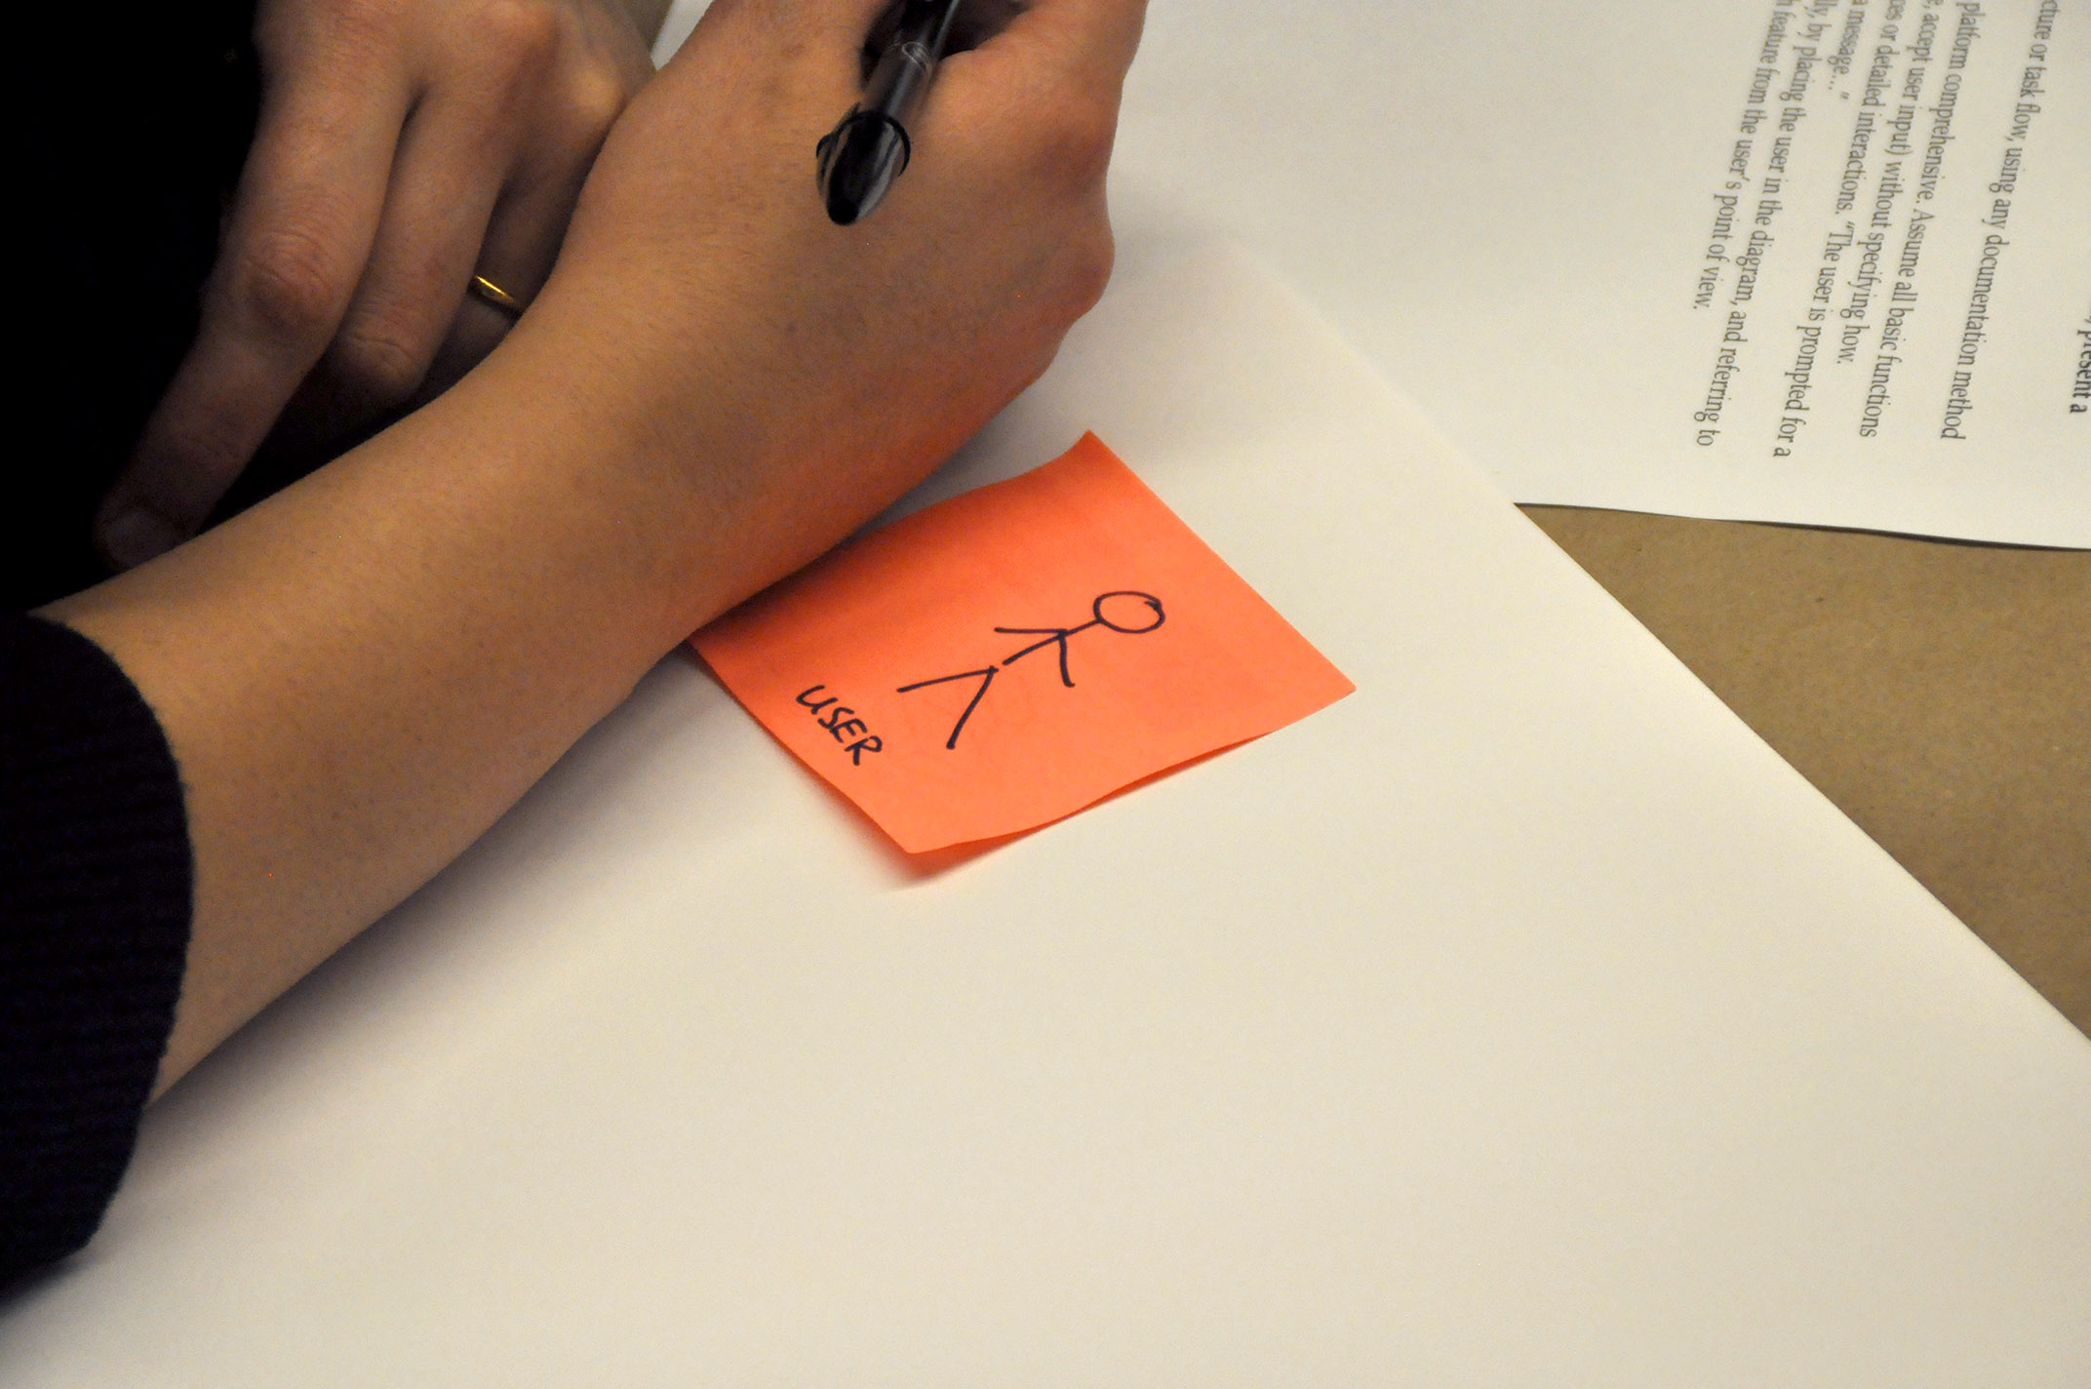
Notes:
Today, I am going to talk a lot about designing and building products. Not for your organization, but for people.
ADD CHINESE TRANSLATION HERE

Slide 3
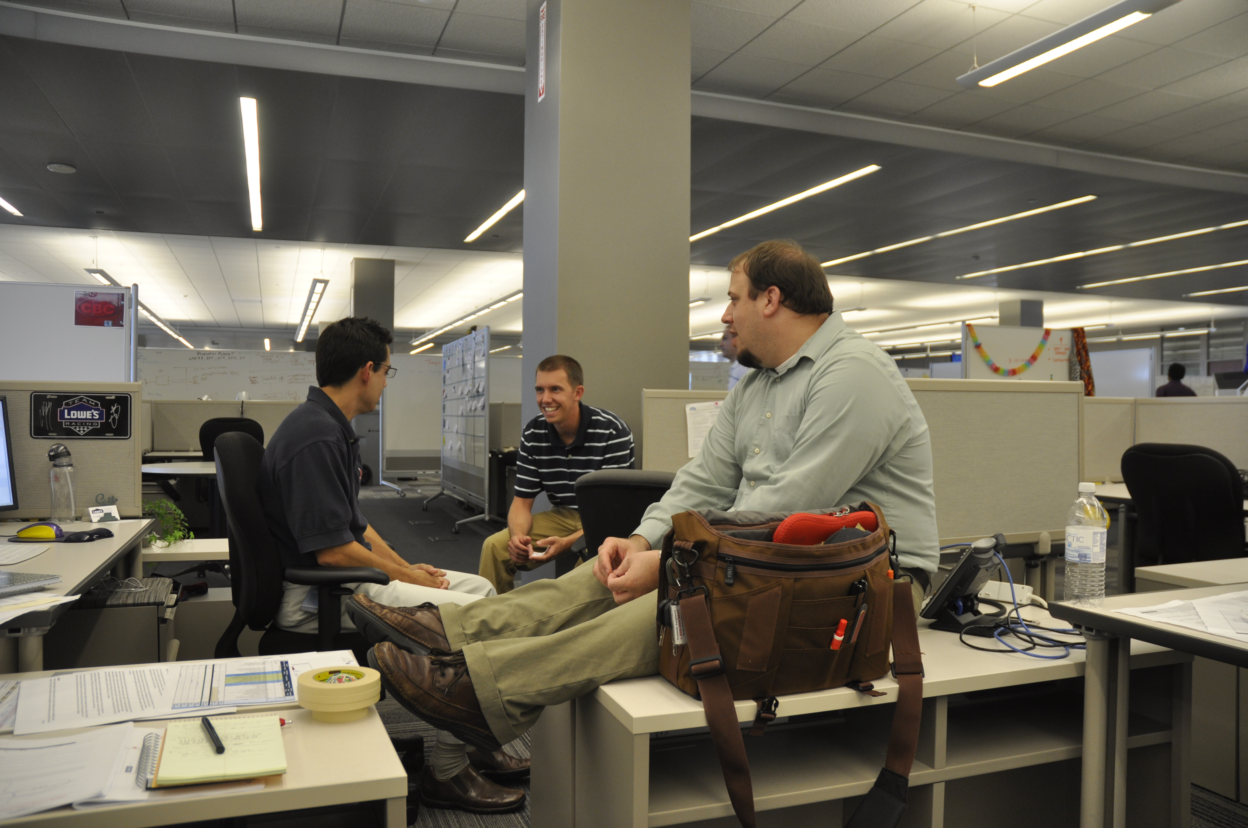
Another Product Owner
Product Owner
Program Architect
User Experience
Notes:
How do we do that? Well, for clients, to achieve goals, as parts of a team.
CLICK
Tell me who is here today. Raise your hand if you are a UX, UI or other Designer…
Writer, Content, Graphics?
Presentation Layer Developer?
Software Developer? Data Architect, DBA, or anything else implementation side?
DevOps?
Product Owners? … Okay, keep your hands up.
ADD CHINESE TRANSLATION HERE

Slide 4

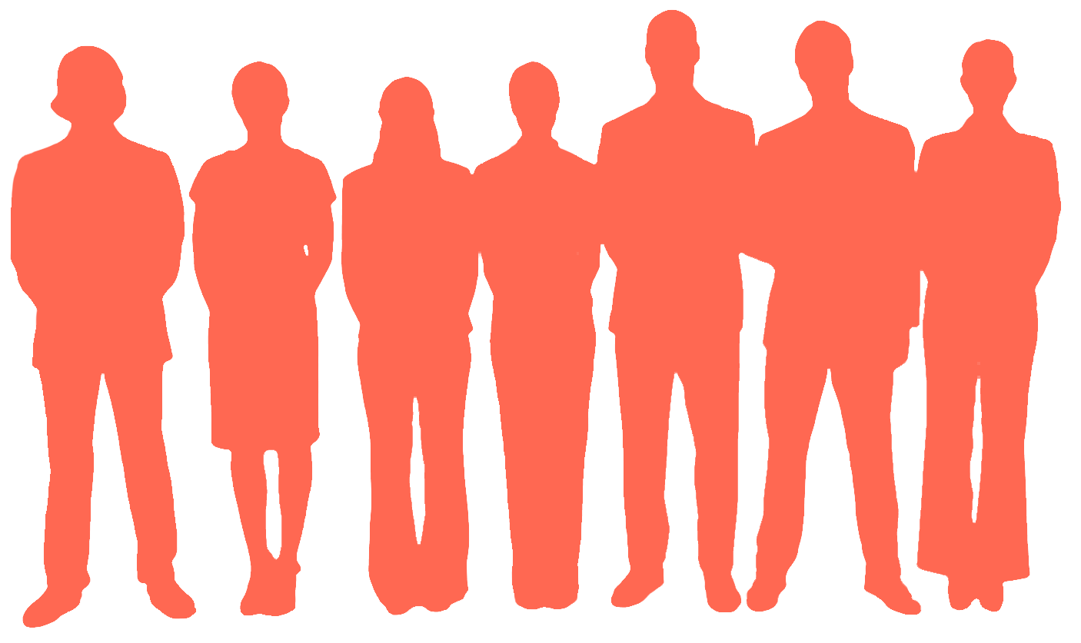
Notes:
We’re going to make some teams for the rest of this session, and you product owners are my team leaders today.
Each of you go to one of the spots on the wall where I have taped up these screens.
CLICK
And everyone else distribute yourselves so we have at least one dev, one designer, and so forth for each group.
Don’t cluster up in general. If a whole team from one company came, your choice if you want to stick together or break up…
ADD CHINESE TRANSLATION HERE

Slide 5
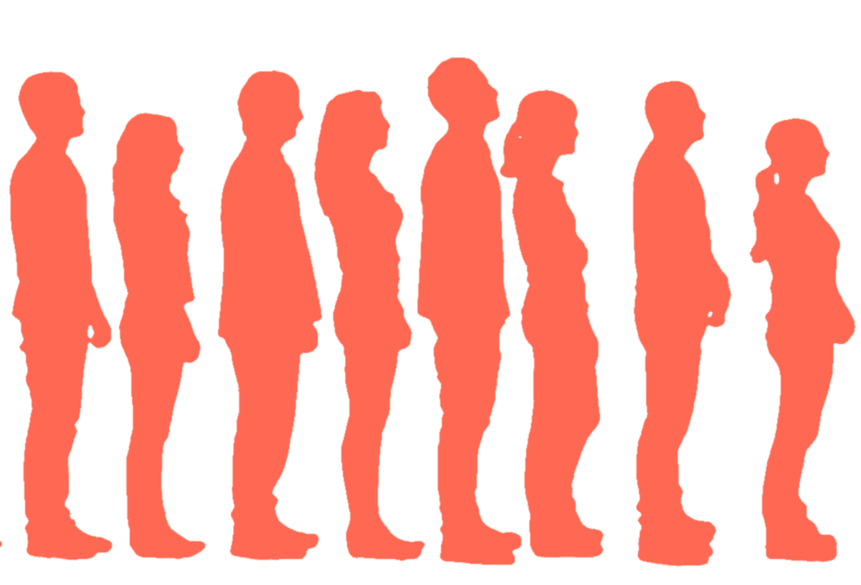
Product Owner
Business
Analyst
User
Experience
Software
Developer
Presentation
Developer
Notes:
Now, Product Owners: Take this piece of paper, and a Sharpie, from me while everyone else organizes themselves like this.
Whoever is the most front-end at the front, and so forth. Product owners, go to the back of the line and keep that piece of paper to yourselves.
And we’re going to play “the telephone game,” solving, then implementing what the Product Owner wants to get done.
EXPLAIN WHAT THAT MEANS, WHISPER TO THE NEXT PERSON ONLY…
Naturally, if you have a way to improve what you were told to do, use your expertise to do that then tell the person in front of you.
And quickly! You have:
4 MINUTES
…
OKAY, YOU CAN ALL HAVE A SEAT IF YOU WANT NOW…
ADD CHINESE TRANSLATION HERE

Slide 6
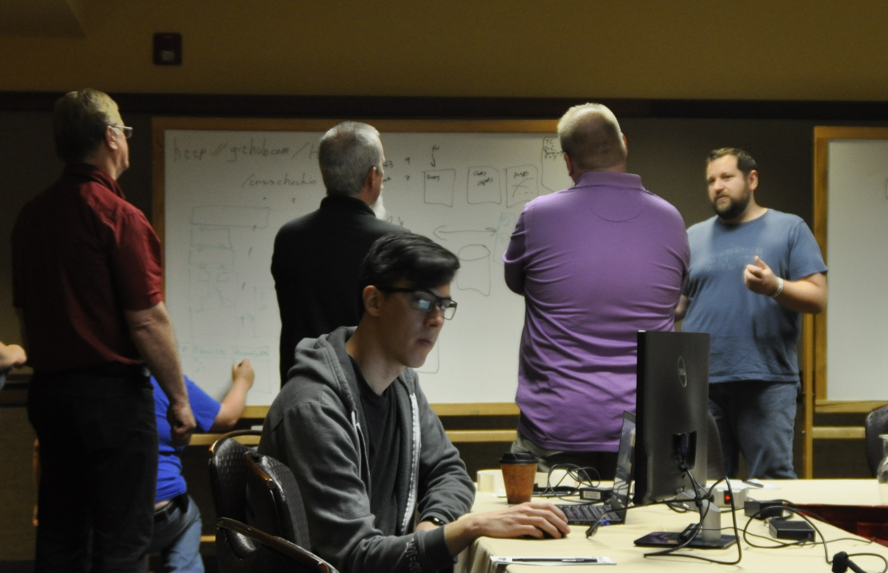
Don’t bet on unicorns.
Notes:
Okay, how’d that go?
Do not get the wrong lesson, and bet on unicorns who can do this all themselves. Do not ignore product, and design, and just start coding. Instead, and what we’re going to do the rest of the day, is involve everyone (well, except this guy who’s on his computer instead) and work as a team.
ADD CHINESE TRANSLATION HERE

Slide 7
Ecosystems are complex.
Notes:
Because complex systems require complex solutions.
Not that this means confusing and cluttered, but let’s be clear that building bad solutions is mostly easier than building good, well-considered, universal solutions.
ADD CHINESE TRANSLATION HERE

Slide 8
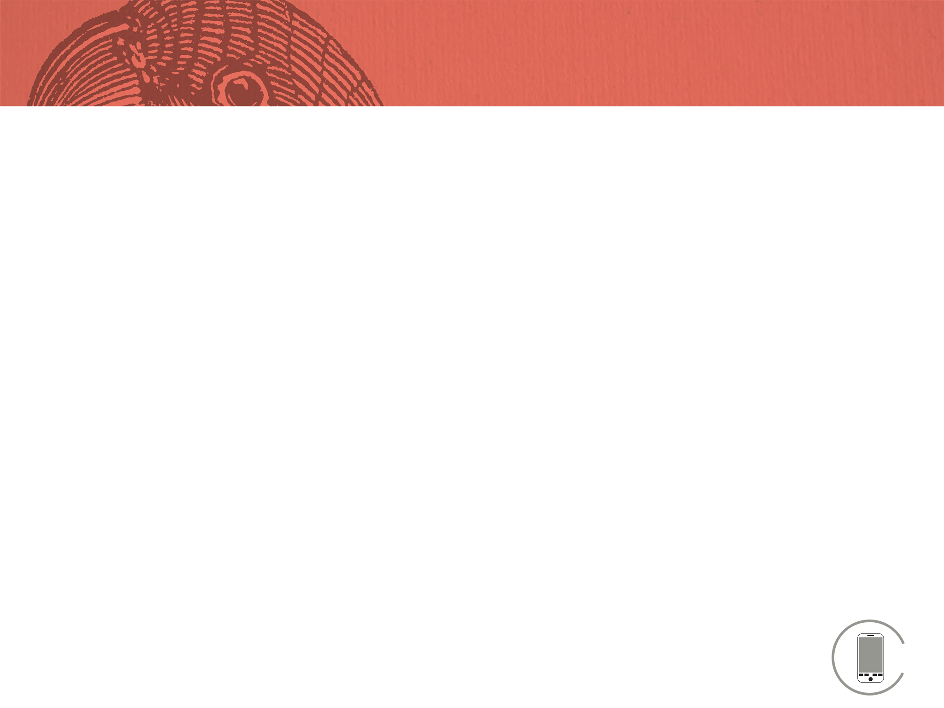
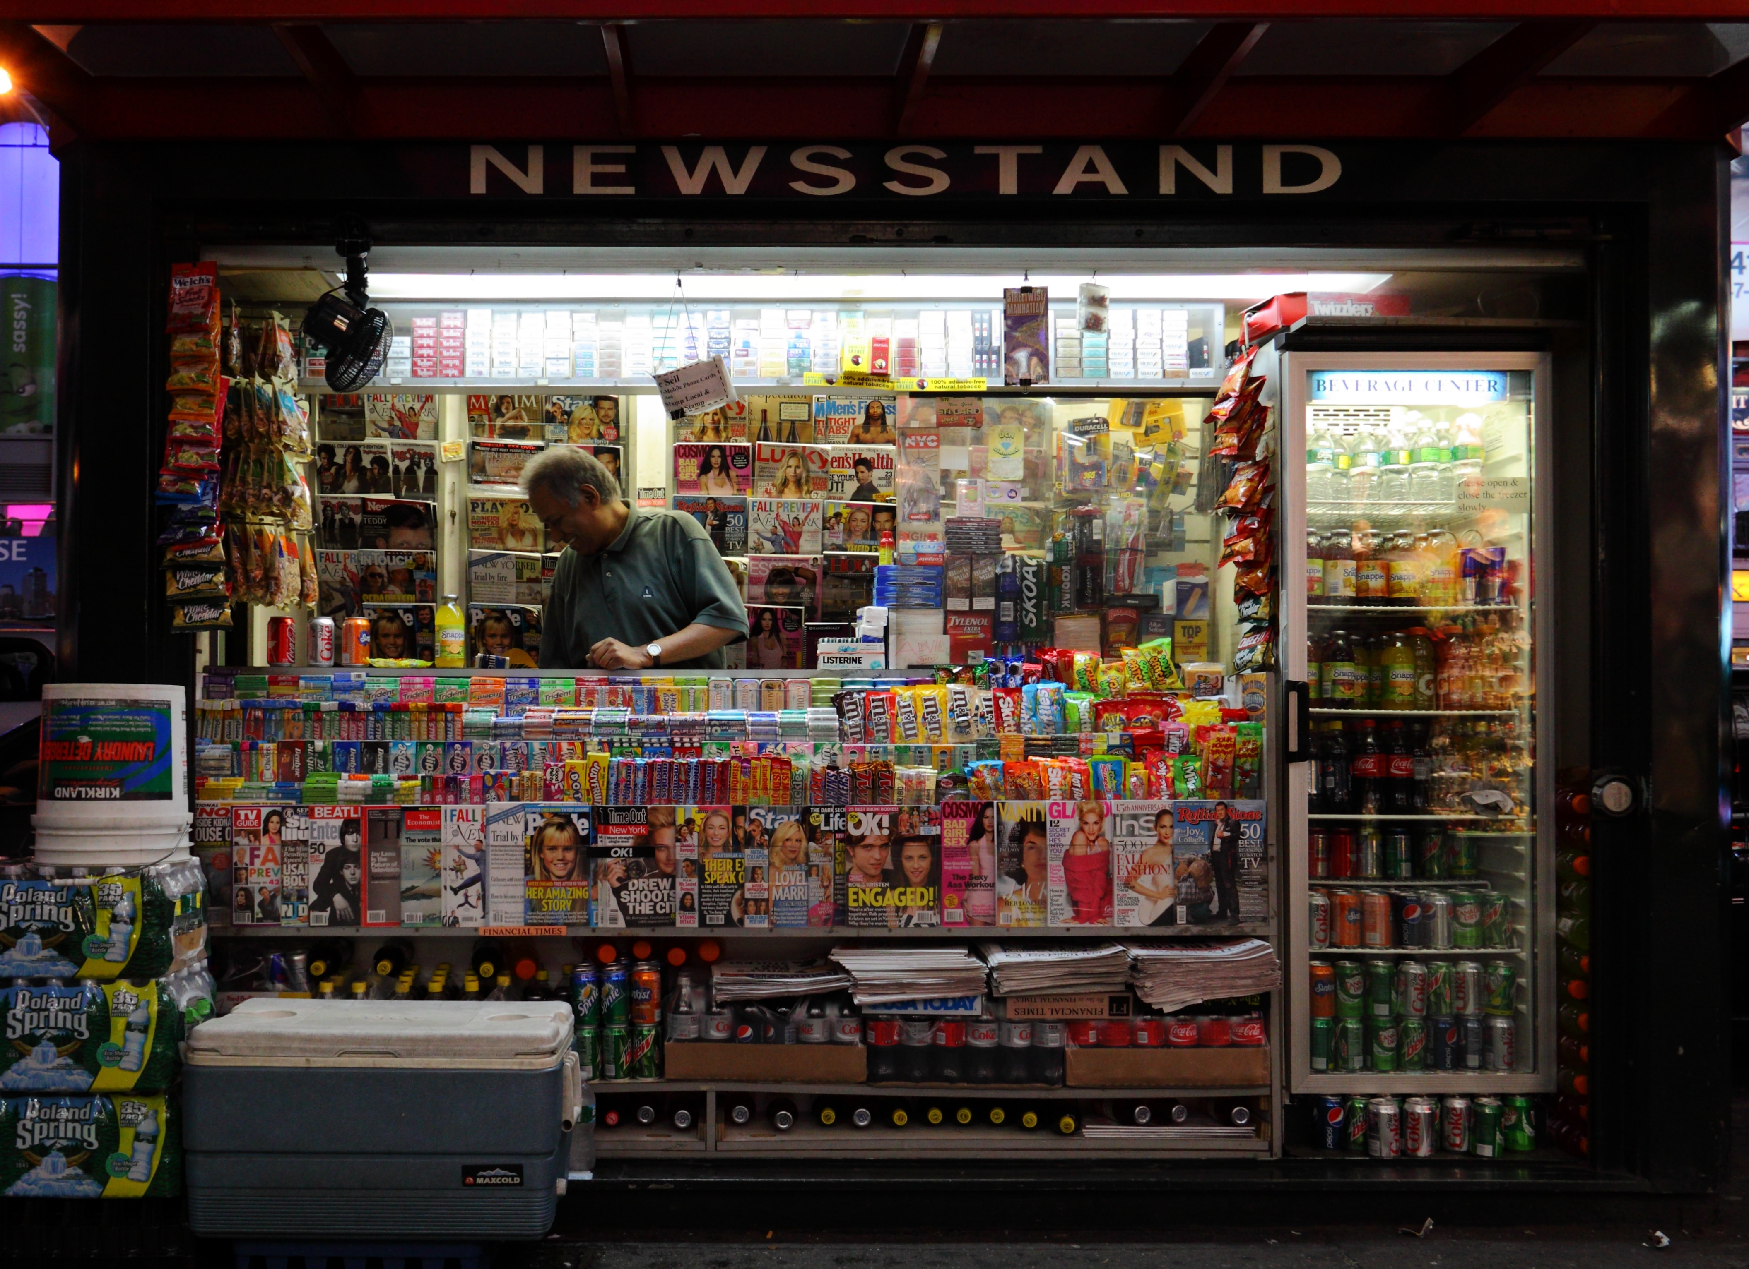
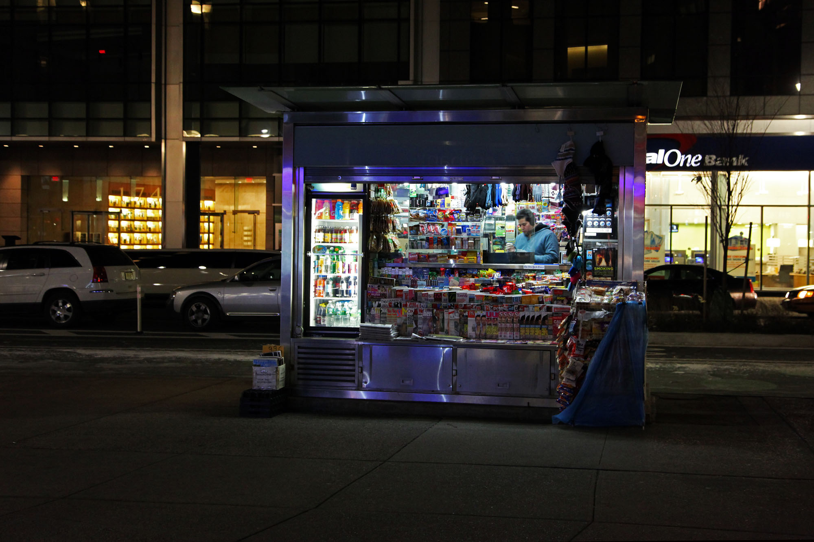
@shoobe01
@techjobslafair
@shoobe01
#mwux14
8
Notes:
As designers, if not humans, we've always been about building ecosystems. Your website has password reset emails, lots of people (like me) have been offering the website on mobile handsets for over 15 years. How about ATMs?
Everything is an ecosystem, and good designers know this. Newspapers and magazines are designed not just to be readable, but to be appealing to the newsstand. And, to have room for mailing labels for home delivery.
ADD CHINESE TRANSLATION HERE

Slide 9
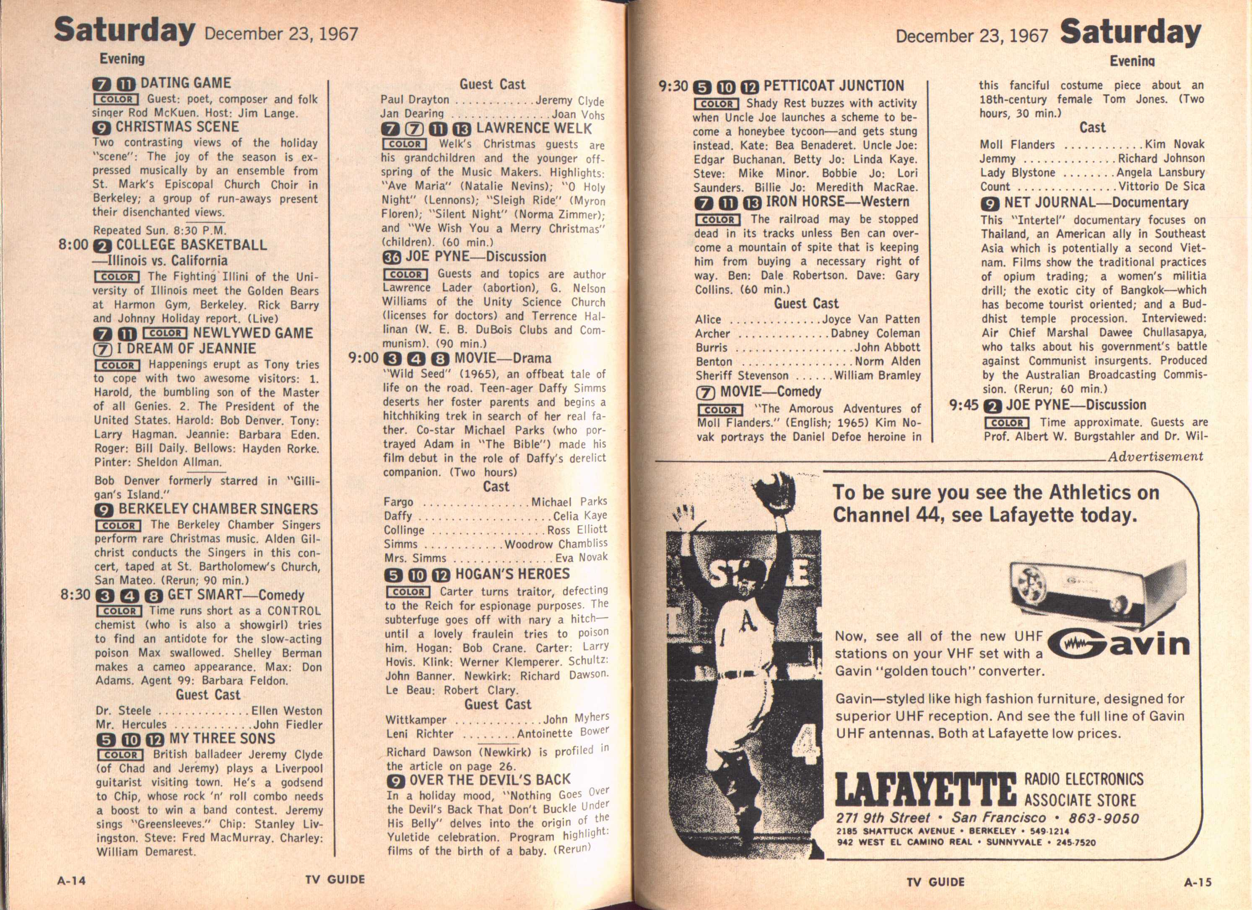
Notes:
Today, a popular magazine sells around 3 million subscriptions a week. Well, from the 60s or so through the 1990s, TV guide was vastly, vastly popular. They sold 20 million copies a week of this [IMAGE]. What is all but a database dump you pay for, and which is also full of ads. You can see why the Internet did so well.
The guys who actually gathered this data realized early on they didn’t make a magazine though. They had a data product. And when the first EPGs came along — the TV-Guide channel that is the first thing that came up when you turned on the early Cable TV systems — the data they had was all ready for it. They had already been storing short and long descriptions (reruns within a week don’t get the full description, or maybe space is an issue), as well as the concept of meta-data well before anyone called it that.
Derived, with some improvements for history, from http://karenmcgrane.com/category/content-strategy/ though I saw it presented instead.
ADD CHINESE TRANSLATION HERE

Slide 10
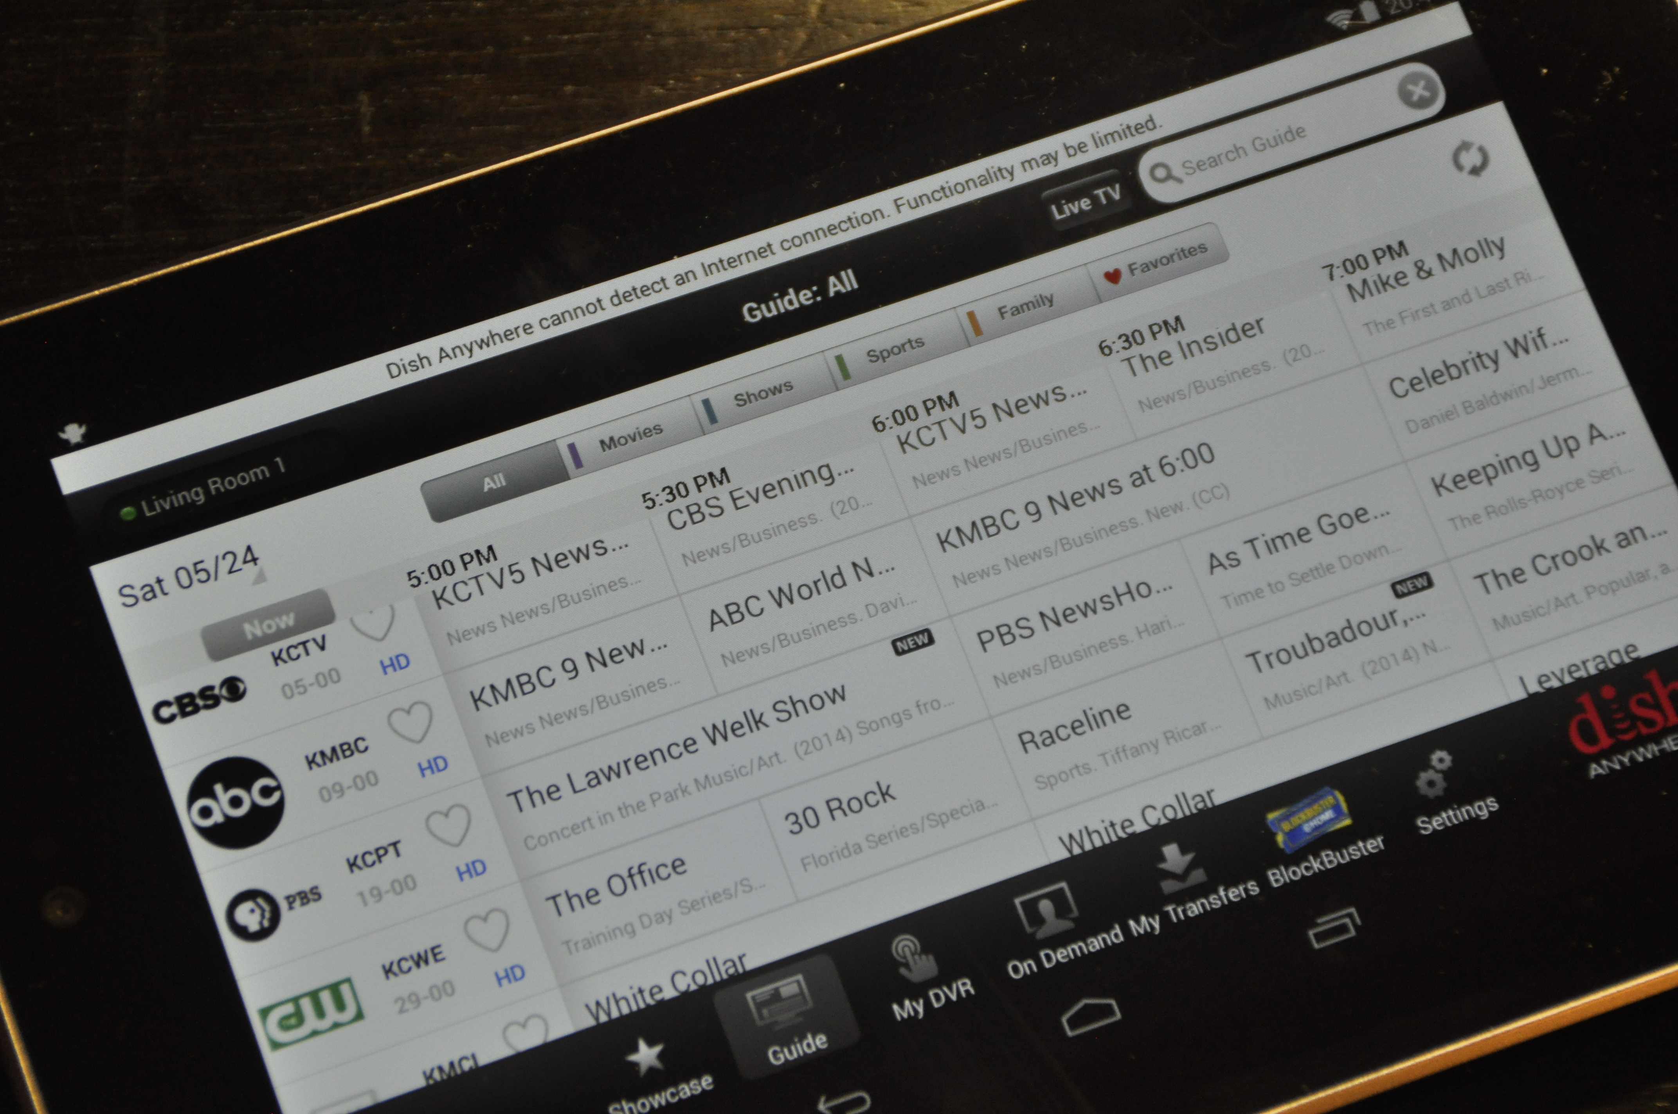
Notes:
Simplifying the story some, what with mergers and acquisitions over the decades, the content we see today on our much more high tech cable, satellite or streaming systems is not just the same basic format, but in some cases is the SAME EXACT CONTENT.
There’s no need to write a new description for that Lawrence Welk show every time it airs, so the original 1979 description is still pulled from the database and used today. It’s all just data.
ADD CHINESE TRANSLATION HERE

Slide 11
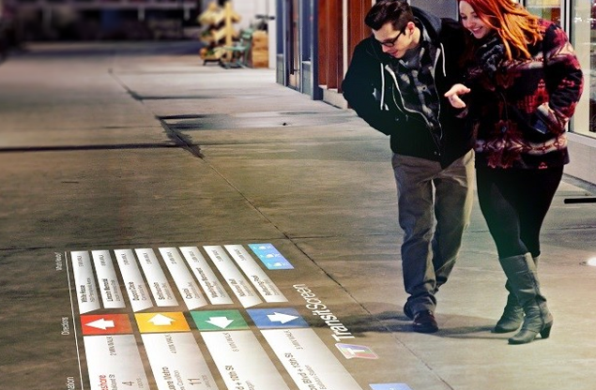
Ecosystems are about the future
Notes:
This is what annoys me about almost everyone selling Anything As A Service. They want you do start from scratch. But the world is full of info, and most often improvements to that are what we want.
This is the same old subway data (and this is real, not a mockup) projected onto the sidewalk, in context. So people walking down the street can see what the trains right under their feet are doing, to determine which one to take, and how long it will take them.
ADD CHINESE TRANSLATION HERE

Slide 12
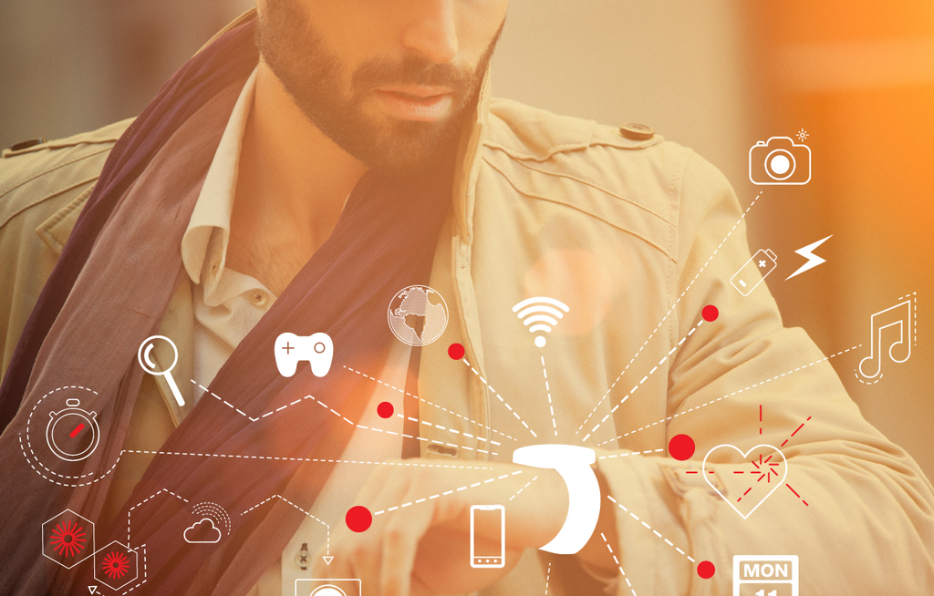
Ecosystems are
for people
Notes:
We need to stop cropping people’s heads off.
Wearables, even more than other products, are about people instead of the device and connections.
ADD CHINESE TRANSLATION HERE

Slide 13
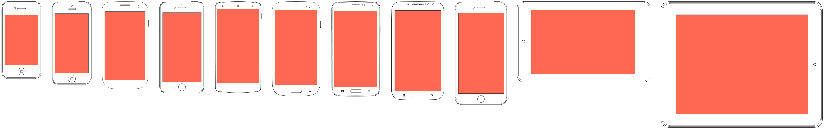
Notes:
Not least of which because systems change. In radical ways. If you are bad at designing for mobile you can get away with the same old stuff on a tiny screen. IoT and wearables are very different.
What’s next? Who knows? But if you design for systems not A System, you are better prepared for it.
STOP designing to pixel dimensions. Stop designing for phone and tablet, because look here: There’s no distinction, but a continuum of devices.
ADD CHINESE TRANSLATION HERE

Slide 14
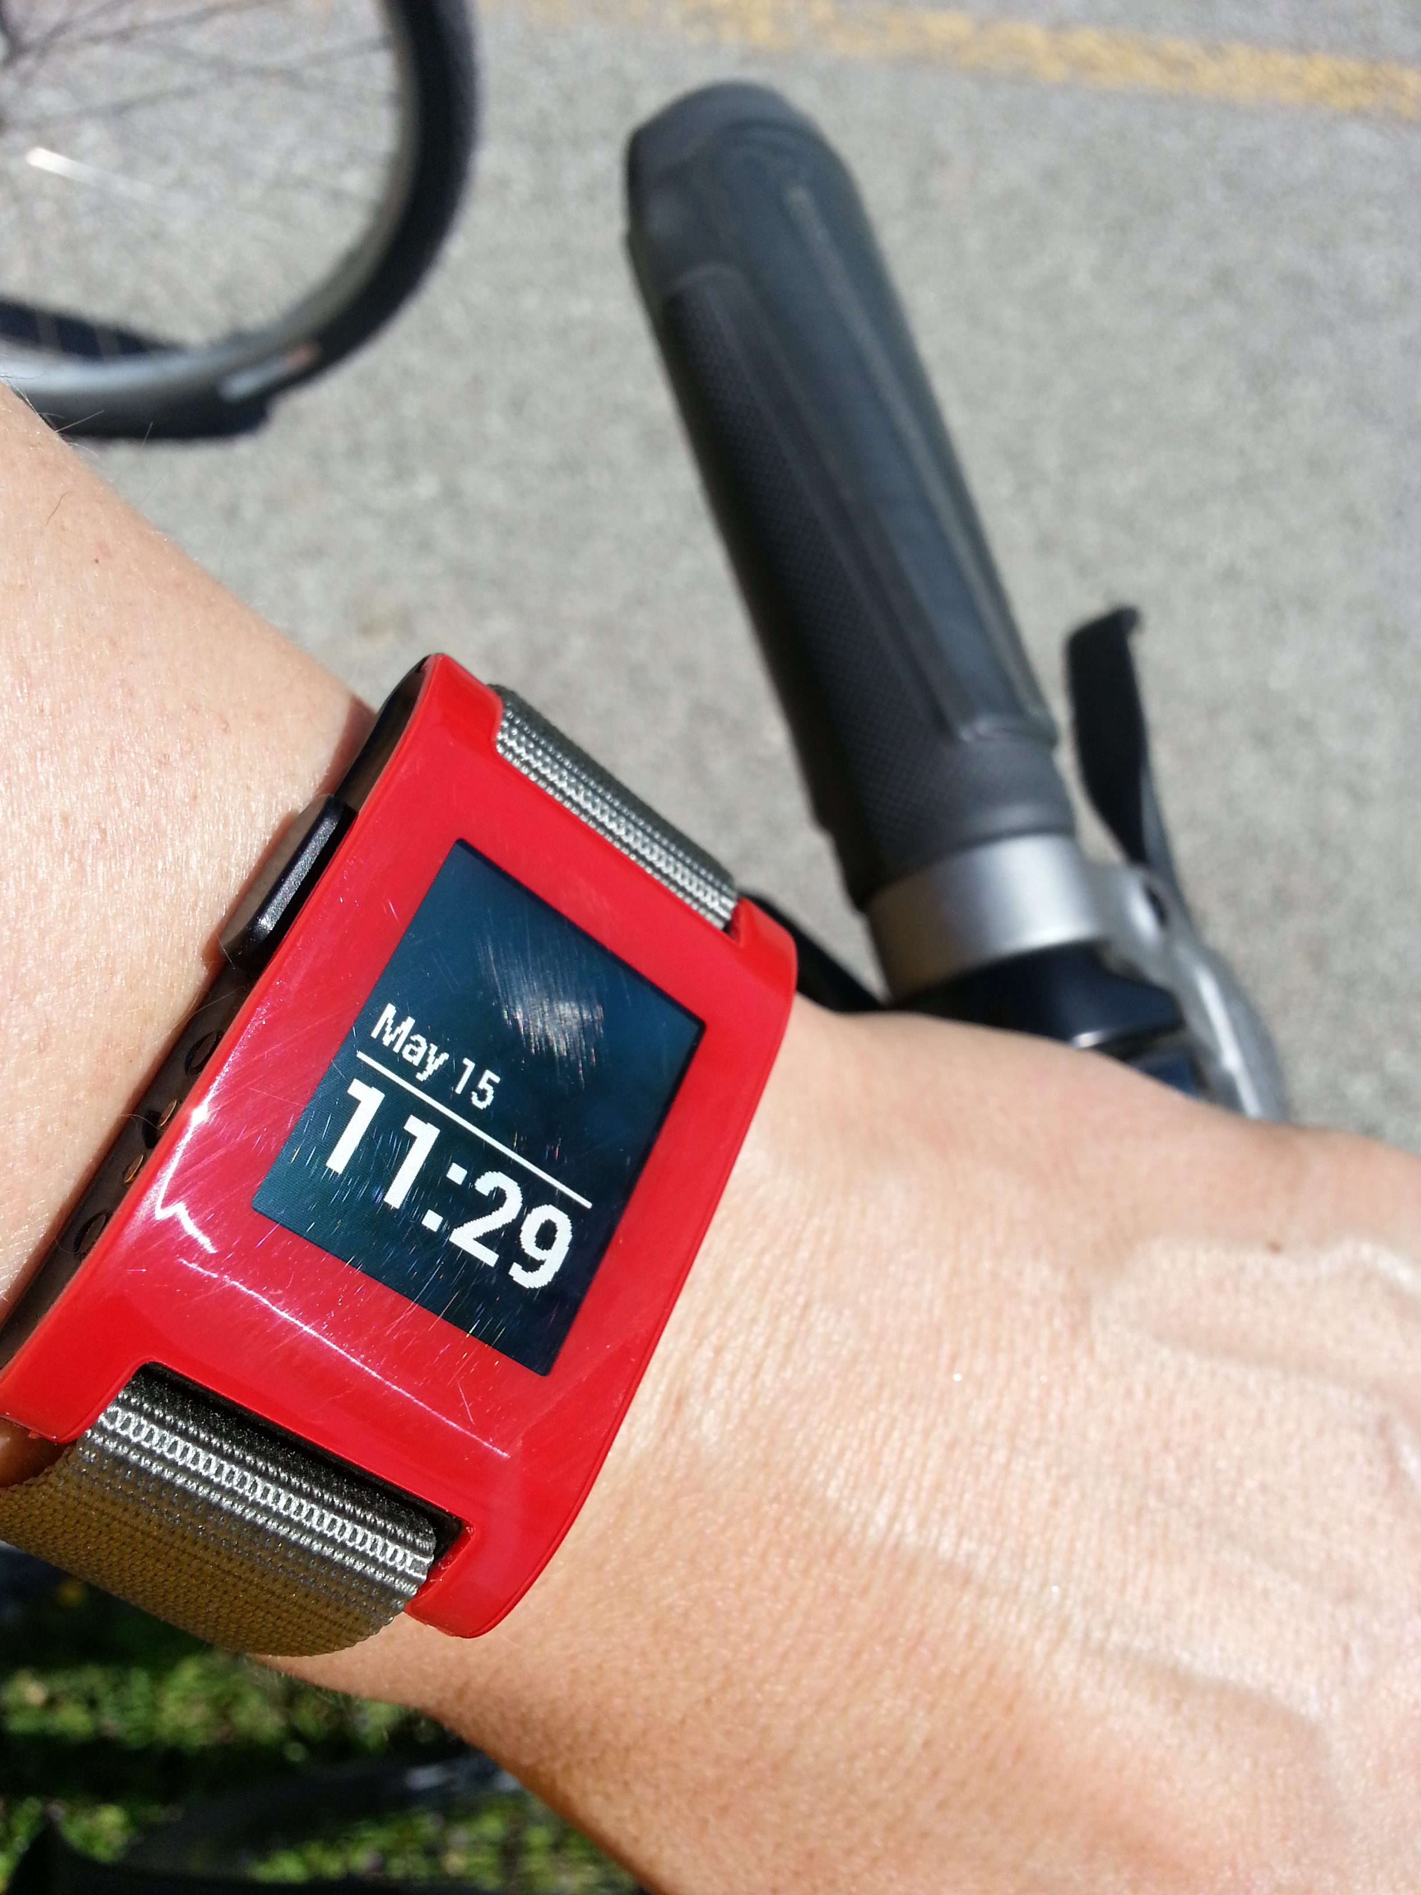
PEBBLE
Notes:
What happens when the Apple Watch comes out? We already know. Just like how 2/3rd of smartphones were phablets before the iPhone 6 Plus, we have this data.
The future is not evenly distributed. This is my Pebble close to two years ago. There are over a million of these out there. Millions more fitness trackers, and smart thermostats, and smart TVs…
ADD CHINESE TRANSLATION HERE

Slide 15
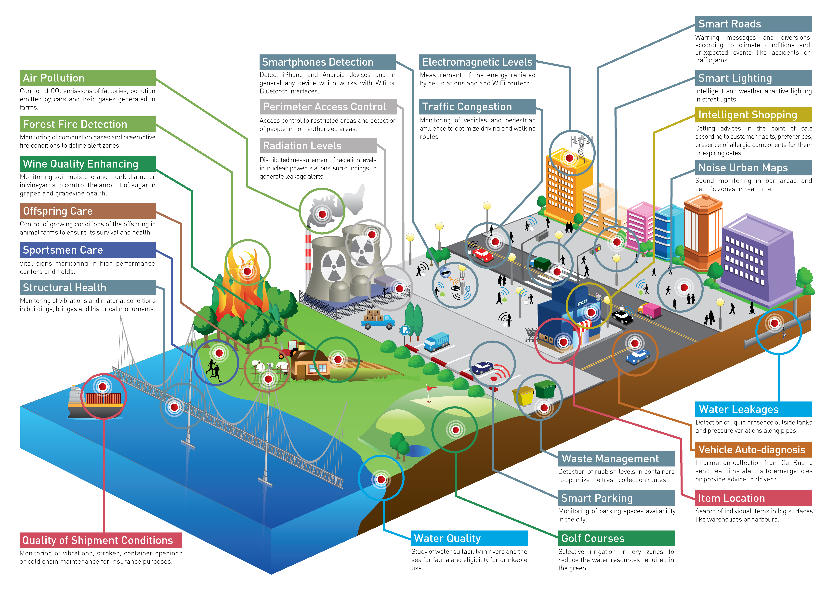
@shoobe01
#mwux14
15
Notes:
And you may be surprised that industry leads the way. There are almost 50 million smart electric meters in the US right now. They are getting smarter, as well.
Start looking up, and you’ll see a lot of antennas hanging off buildings, power, phone and cable lines, on top of trucks. The Internet of things is here, just commercial and industrial.
ADD CHINESE TRANSLATION HERE

Slide 16
EXERCISE:
Let’s make our own service.
Notes:
Okay, let’s make our own system. For the rest of this session, I am not going to give you problem or design, but you will work on your own. Remember, not a website, or an app, or a smartwatch, but a solution or service.
Or even a problem, and you all can try to solve it. Start thinking of what you might want to work on, while I talk at you for a bit longer…
ADD CHINESE TRANSLATION HERE

Slide 17
Information Architecture
Notes:
Information Architecture is a term or concept I hope and pray you have heard. You probably have designed to it. And you may have mis-used it, so I have to talk about it a bit even if you are an experienced designer already.
IA is the underlying organization, structure and nomenclature that define the relationships between a product’s content and functionality.
ADD CHINESE TRANSLATION HERE

Slide 18
Information Architecture
is not just navigation.
Notes:
Navigation communicates to the user where they are and allows access to the features and information on the site or in the app, or printout, or DVD or whatever. But it’s an abstraction of the complete structure. IA is not navigation, but the structure you derive navigation from.
IA is not just digital, or just about one channel. You can and should do most of the IA work before you have settled on a platform. I often do that, and use the structure to help define what features go on which platform. Or even to make informed choices about the platform needs.
Information architecture is not about the UI, but the information, and good IA considers the expectations and experiences of the users.
ADD CHINESE TRANSLATION HERE

Slide 19
“Error is viewed, therefore, not as an extraneous and misdirected or misdirecting accident, but as an essential part of the process under consideration.”
– John VonNeumann
“Error in Logics,” 1952
Notes:
For a long time, we have assumed computers are infallible, but long ago they were not, and lately we have realized that in aggregate, there are still problems.
Resilience engineering is something used to keep big, reliable services like Google, Facebook, Etsy, Flickr, Yahoo, or Amazon online. At a deep engineering level they follow practices and procedures to assure their systems are not brittle, and avoid failure or fail gracefully and can be fixed easily even with power failures, network breaks and typhoons.
Resilience is usually defined as the ability of a system to absorb disruptions without tipping over to a new kind of order. A building when exposed to too much lateral ground movement settles into a state of “pile of rubble on the ground” unless you design it to resist the disruption of earthquakes adequately.
ADD CHINESE TRANSLATION HERE

Slide 20
Embrace failure and complexity.
Notes:
You can’t prevent these problems, so you have to expect and plan for them.
From our point of view, remember is that everything you do is too complex to adequately model and map. Assume you have always missed something, so you are prepared to deal with the unexpected, both in design and so you can modify your product over time to take advantage of new ways you find people using your information.
ADD CHINESE TRANSLATION HERE

Slide 21

Notes:
I say there’s also something called Resilience Design. Here’s a simple example…
Though I love my smartwatches, I also still wear normal dial watches. One is a dive watch, because it’s shiny, not because I am a diver or anything. It is one of those with a twisty ring around the outside. That part with the numbers here twists around.
If you don't know, and I didn't until recently, this is used as a simple timer. But on mine, and on all dive watches (vs. Aviators watches), the ring only goes one way. The clicky detent lets it go counter-clockwise, only. WHY? … Because it's for timing remaining air. The ring might get bumped and change it's setting. Having it show less time might be inconvenient, but going the other way might kill you. And, you don't even need to know this. It just works. That's the sort of brilliantly-simple answer I am talking about with resilient design.
ADD CHINESE TRANSLATION HERE

Slide 22
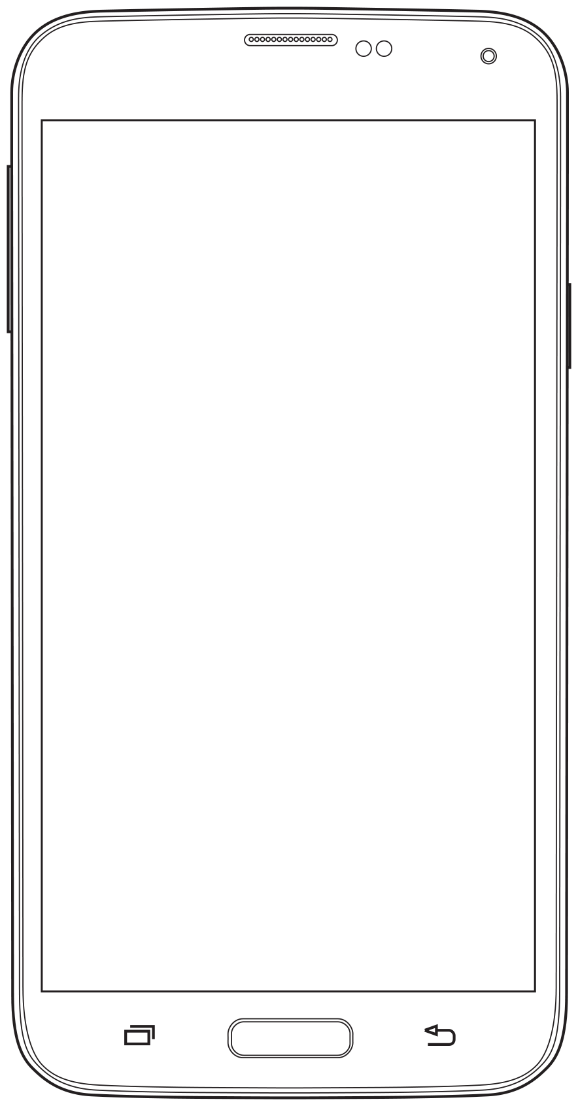
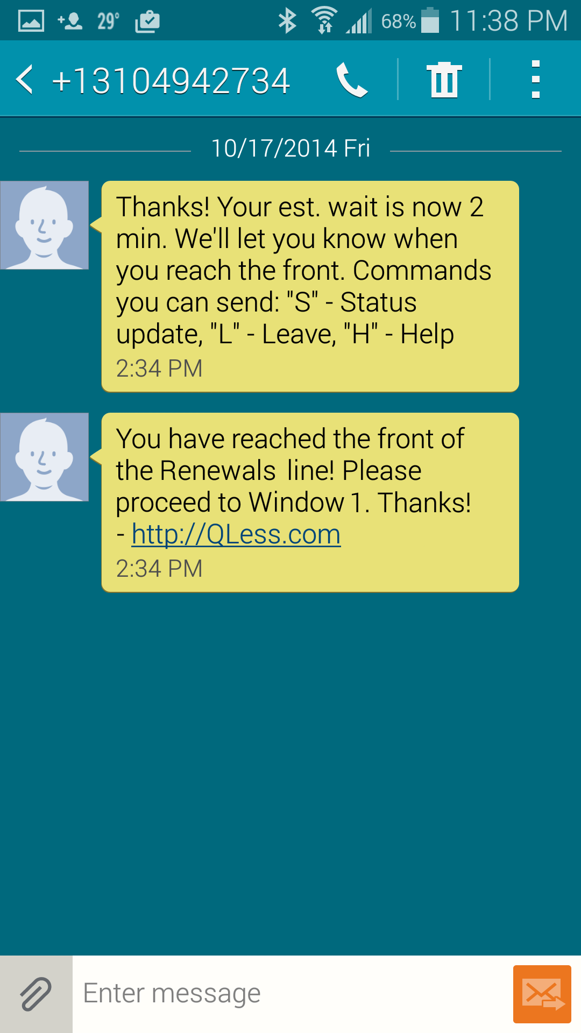
Notes:
Resilient design doesn’t just mean removing error messages, but embracing that people use your product in various ways. Providing alternative paths, like letting people “wait in line” at the DMV with text messaging.
ADD CHINESE TRANSLATION HERE

Slide 23
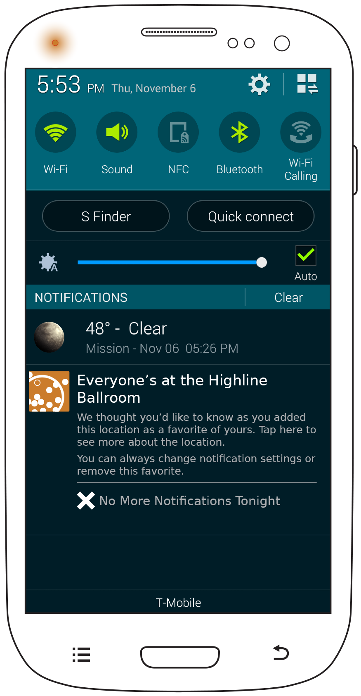
Notes:
Or removing the whole principle of you asking a computer to do anything. We can collaborate with our computers, so they can analyze data and push it to you…
ADD CHINESE TRANSLATION HERE

Slide 24
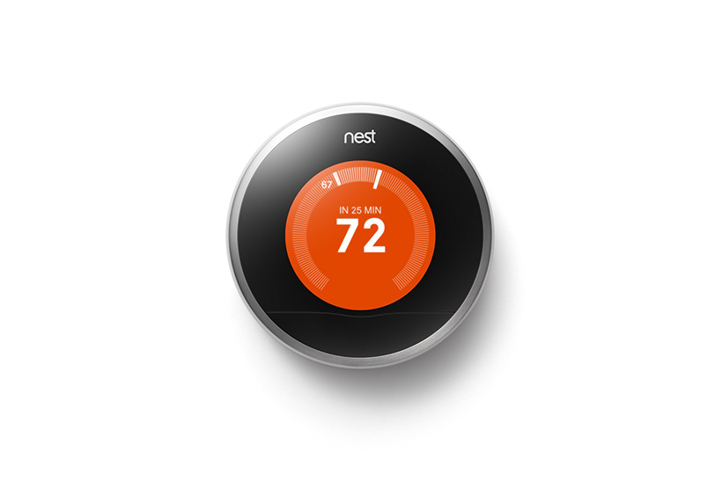
Notes:
…or simply change your environment, and only notify only if you bother to go check. Usually because something is wrong.
ADD CHINESE TRANSLATION HERE

Slide 25
EXERCISE:
Let’s make our own service.
Notes:
Okay, got some good ideas? Get with your teams and take THIRTY SECONDS each to pitch your idea to the rest of the team.
As a group, agree on ONE idea to work on. If serendipity hits, sure you can combine them into one product.
5 MINUTES
…
ADD CHINESE TRANSLATION HERE

Slide 26
Don’t draw
Users first
Ecosystems, not systems
Work in context
Annotate, describe, understand
Evaluate, and validate
Notes:
We’re not going to be able to hit up every step in an ideal process to design your system, just for time. But the first one is important…
ADD CHINESE TRANSLATION HERE

Slide 27
Don’t draw
Users first
Ecosystems, not systems
Work in context
Annotate, describe, understand
Evaluate, and validate
Notes:
Don’t draw.
I came to many of the convictions in my career by massively failing and wasting my time. I re-confirmed it recently, building a very beautiful product that’s somewhat odd and disjointed. Though we are working on it.
Because if you go to drawing too early, which I and many of us are naturally inclined to do, we get locked into interface and interaction decisions. We make choices that look good based on specific steps in the process, not the whole ecosystem. For the recent failure I am mentioned, we have FIFTEEN different styles of dialogs. That’s just stupid.
The first thing to do when designing is to resist the urge to draw at all. Instead, we need to understand, and define.
ADD CHINESE TRANSLATION HERE

Slide 28
Define, then design.
Notes:
And you define the basic outlines of your product.
What is your audience?
What are their goals?
What are they using now to solve this need?
Why is your organization doing this?
ADD CHINESE TRANSLATION HERE

Slide 29
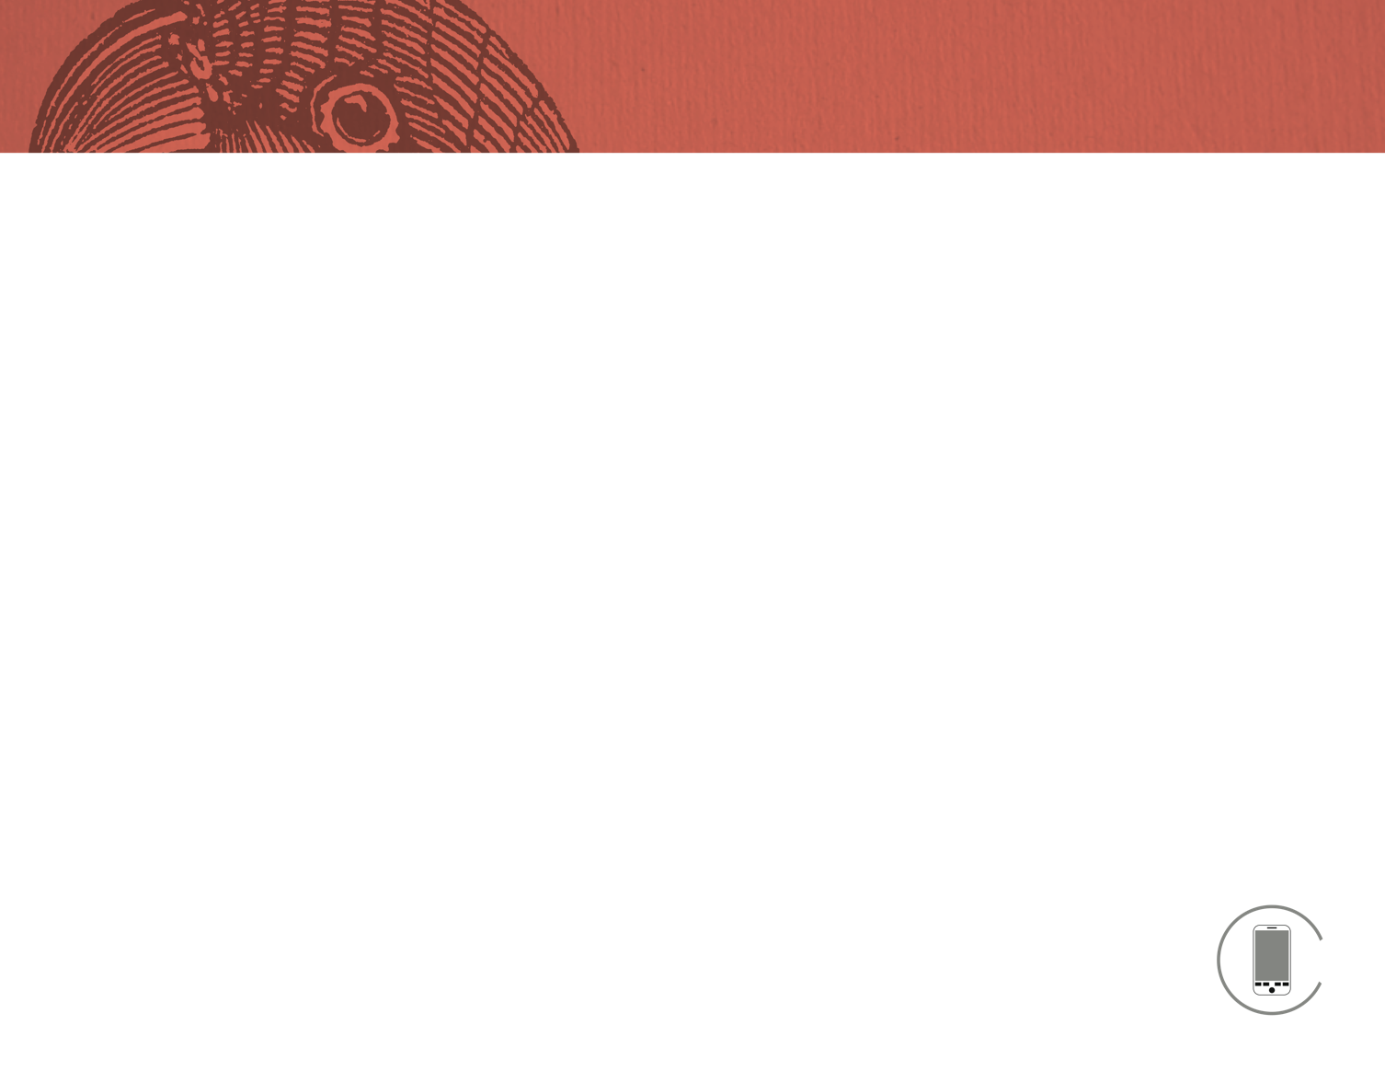
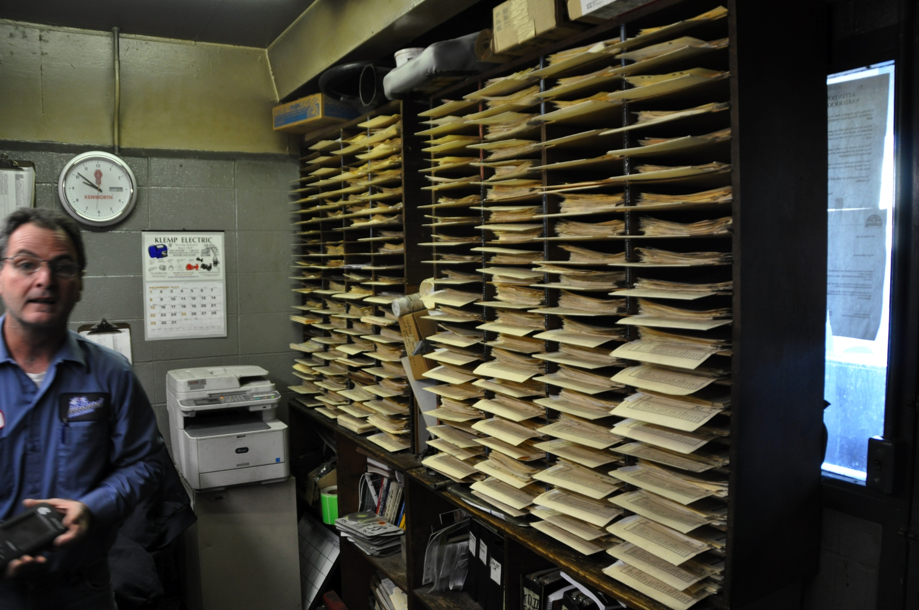
@shoobe01
#ConveyUX
Notes:
While many of these are interesting, often the best way to understand some of them is to answer “what are they using now.” Very often, it’s surprising. It’s not a website, or any a competing product. Often it’s post-it notes around the edge of their monitor, notes on the fridge. Drawers full of labels and manuals. Or even nothing.
The photo is from a site visit I did semi-recently, where I am tested a mobile app to do something about smartphones connecting to trucks. These are the records of this maintenance shop. There is NO good digital product for the legally-required recordkeeping for their 130 trucks.
In the old days we wanted to replace paper with sitting at a computer to solve problems. Now we can more closely emulate the environment, and the overall user context. Ethnography (sitting with the user to understand how they go about their day) is even more important. Find your users.
ADD CHINESE TRANSLATION HERE

Slide 30
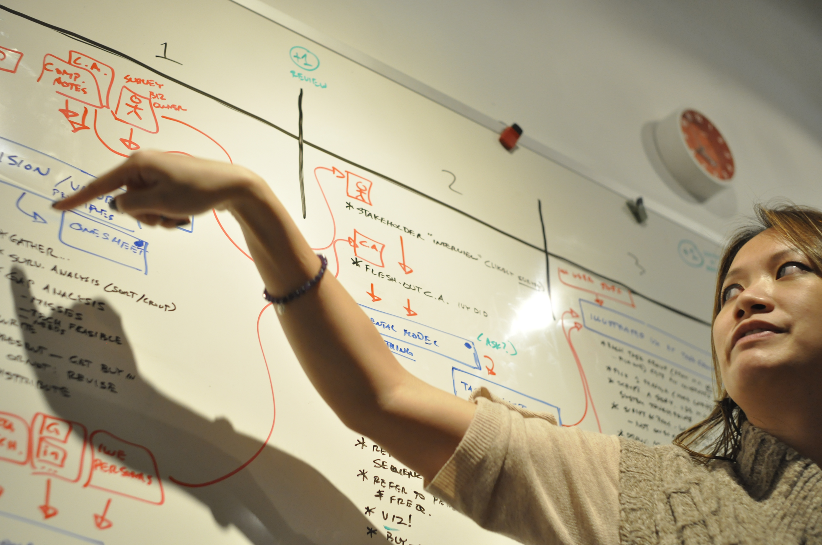
Notes:
Often before I visit users, I try to elicit the institutional knowledge of the organization I work with. We workshop, getting everyone into a room and gathering information about current processes, methodologies, business practices, goals, complaints, etc.
ADD CHINESE TRANSLATION HERE

Slide 31
What is the product?
You are in an elevator with a chief executive of your company. He asks, “what are you working on these days?”
In one short sentence, using plain (non-technical) language, explain what the product is.
What is its one, main purpose?
Pick a single feature of the product you think is critical and express it in as few words as possible. 1-2 word phrases are perfectly fine (“receive cards”); these do not need to be complete sentences. Do not consider technology, UI, wording or other content at all.
Now, answer it again. You may answer as many as five times in total. Do not restate any points; each one should be unique.
What one problem or concern does it solve?
Products are pursued as a result of a business opportunity, or a business problem. Consider any opportunity to be a “problem” in the sense that its something the company is not pursuing (so a missed opportunity for now).
Who will use this product?
Instead of trying to design the product for everyone, we will be focusing on feature sets, and interface designs that meet the primary needs of a small but focused set of users. These should not be market segments as they exist today; inst
Notes:
There are fairly formal ways to do this, which I like to talk about because they work so very, very well.
If you just ask people what they know, they do not know. If you ask them to work together, they generally do not, but there are tricks to get the information anyway.
ADD CHINESE TRANSLATION HERE

Slide 32
In one short sentence, using plain (non-technical) language, explain what the product is.
What is its one, main purpose?
Pick a single feature of the product you think is critical and express it in as few words as possible. 1-2 word phrases are perfectly fine (“receive cards”); these do not need to be complete sentences. Do not consider technology, UI, wording or other content at all.
Now, answer it again. You may answer as many as five times in total. Do not restate any points; each one should be unique.
What one problem or concern does it solve?
Products are pursued as a result of a business opportunity, or a business problem. Consider any opportunity to be a
Notes:
Today, for the product you guys have all settled on, we’re just going to do one of the questions. It’ll be okay; we can use this to inform our design very well.
Everyone take a Post It pad and a sharpie. And nothing else. This is one of the tricks, to keep the number of words you write down. Don’t let your participants pull out pens, or use bigger pieces of paper. Force them to boil it down to key thoughts.
Then, you will all write down this, the one main purpose of the product. Then repeat that, one at a time, until you have no ideas. Keep it to yourself. We’ll share in a minute.
Take FOUR OR FIVE MINUTES for this.
ADD CHINESE TRANSLATION HERE

Slide 33
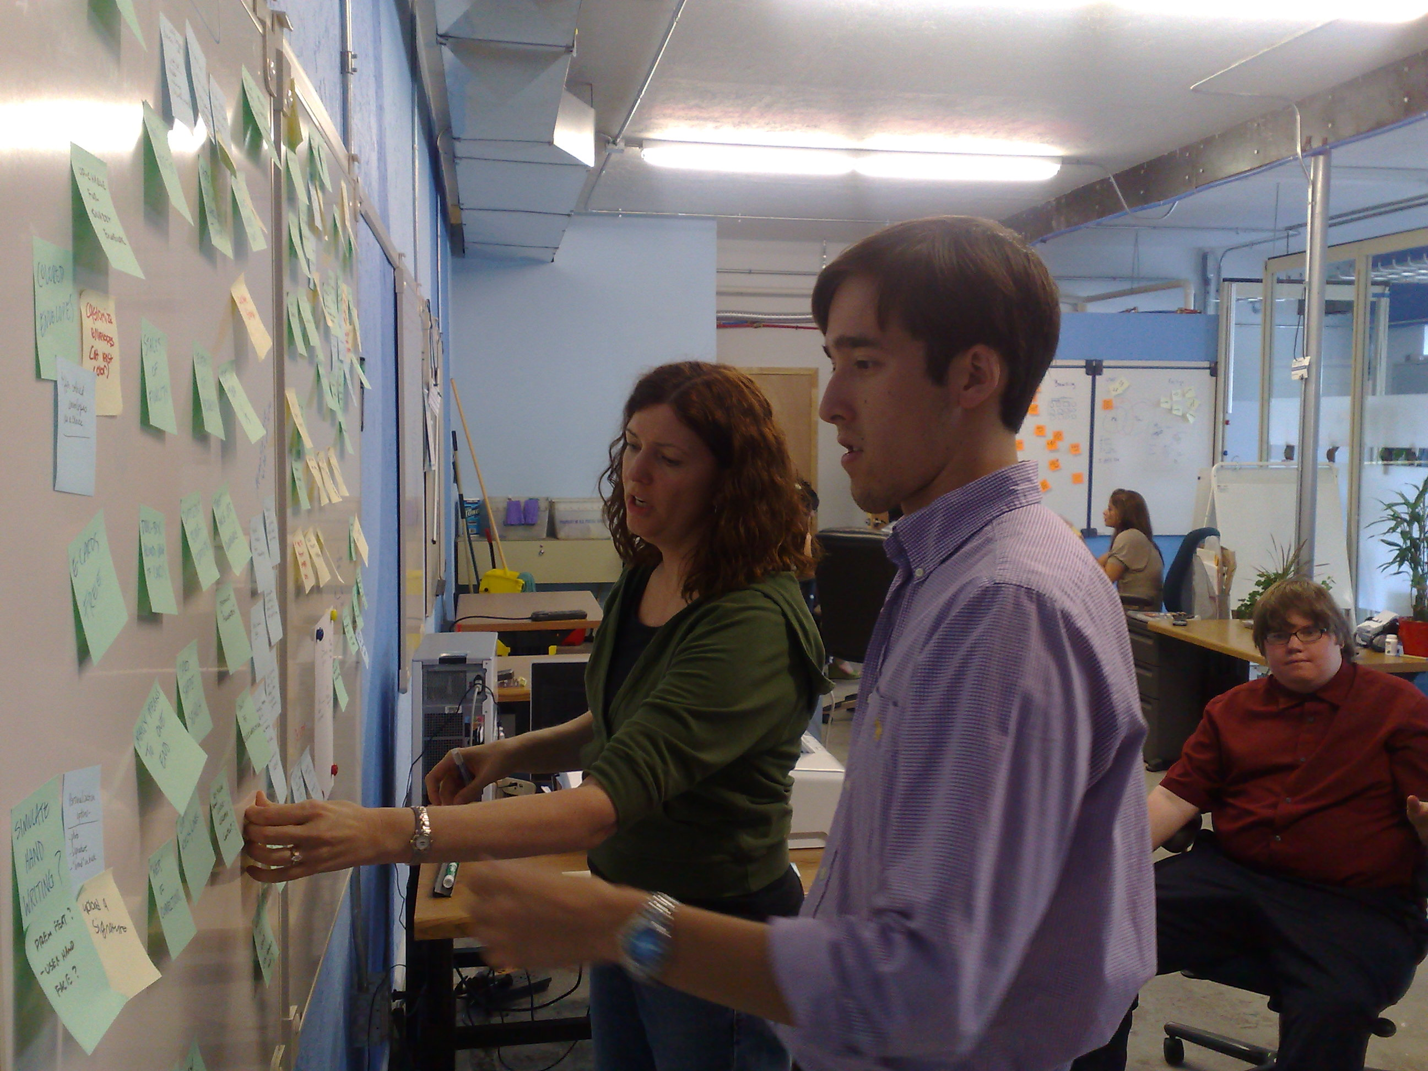
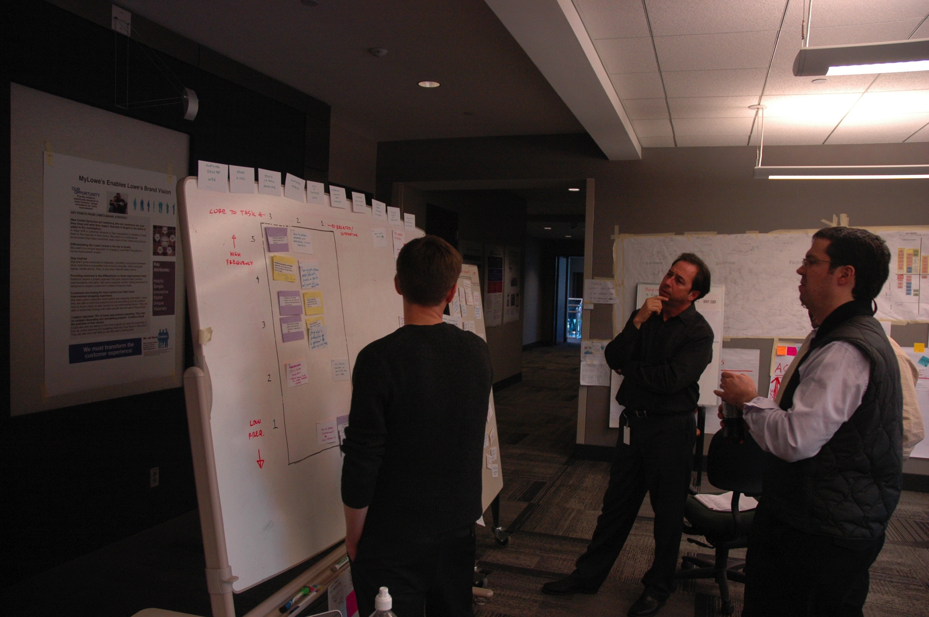
@shoobe01
#ConveyUX
Notes:
…
Now, put them all on the wall. And once you have done that, feel free to move everyone else’s cards around, too.
ADD CHINESE TRANSLATION HERE

Slide 34
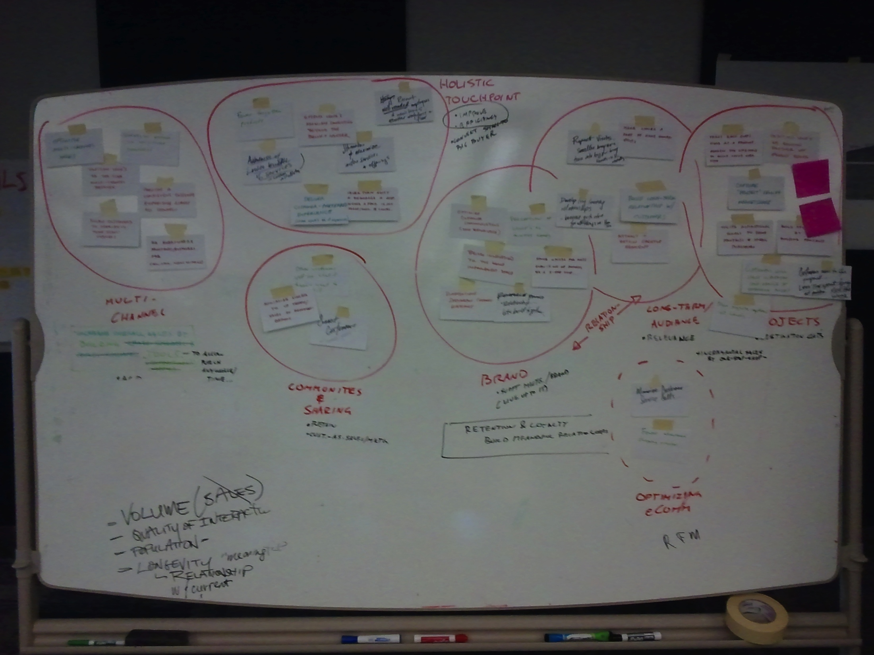
@shoobe01
#ConveyUX
34
Notes:
…And when you stop clustering, you will end up with this. Labeled groups of key features, and functions.
Do that now, and I’ll walk around and help as needed.
TIME LIMIT:
Done:
I like these not just because it’s an effective data gathering method, or because it’s easy to make device-agnostic and user-centric,
but because it’s a collaborative method. Inherently. It is set up to assure that everyone contributes equally.
And I can even demonstrate this and do so in some workshops.
http://www.uie.com/articles/kj_technique/
ADD CHINESE TRANSLATION HERE

Slide 35
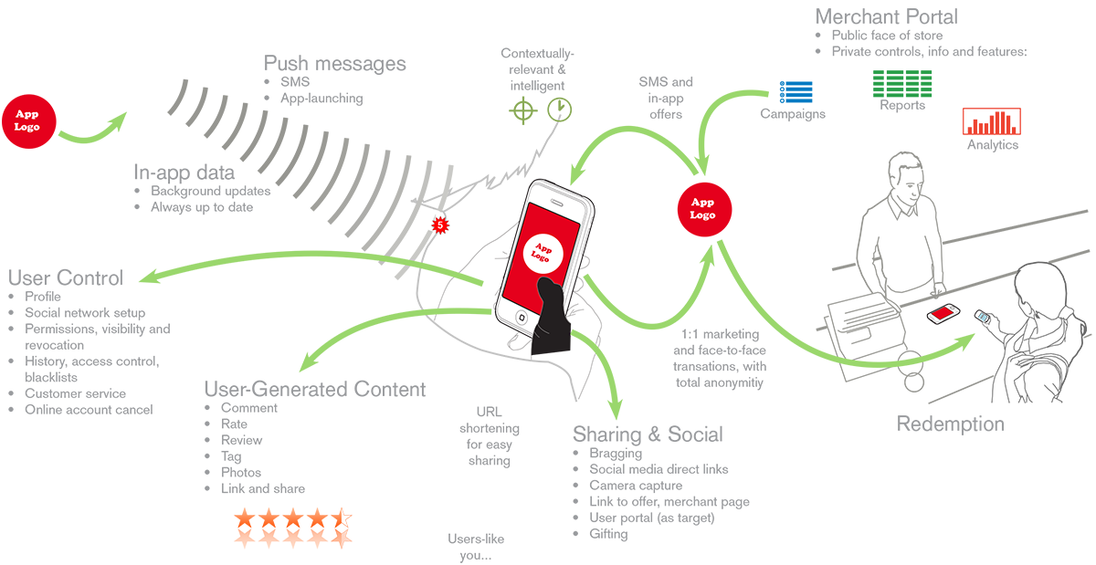
Notes:
What you have now ended up with is a map of your product, not unlike this. Something user-centric, product-focused, and simple though about a complex product.
Now we’re going to expand on that. We’re going to directly take that information gathering exercise and make an IA diagram, user task flow, or whatever solves the needs.
There are many ways to draw this. But most of all, make sure you talk about services, data, sensors, networks and USERS. Not screens, pages, buttons.
ADD CHINESE TRANSLATION HERE

Slide 36
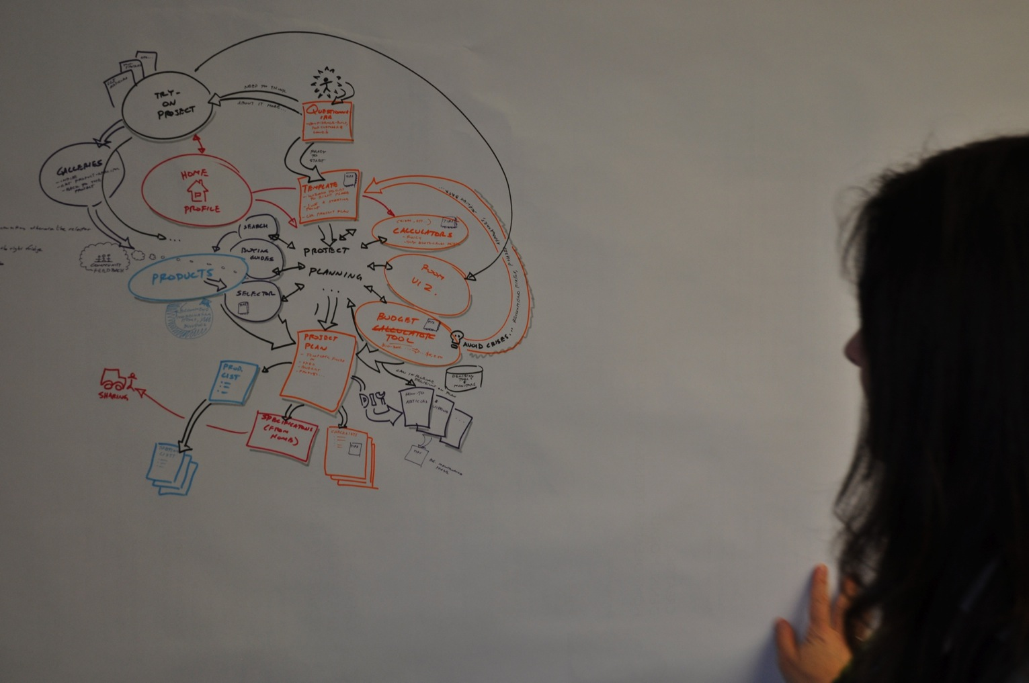
36
Notes:
It doesn’t have to be pretty. Just start with boxes, or even literally take post-its off the wall and start the diagram from whatever else you have done, by gathering requirements from your users or clients.
ADD CHINESE TRANSLATION HERE

Slide 37
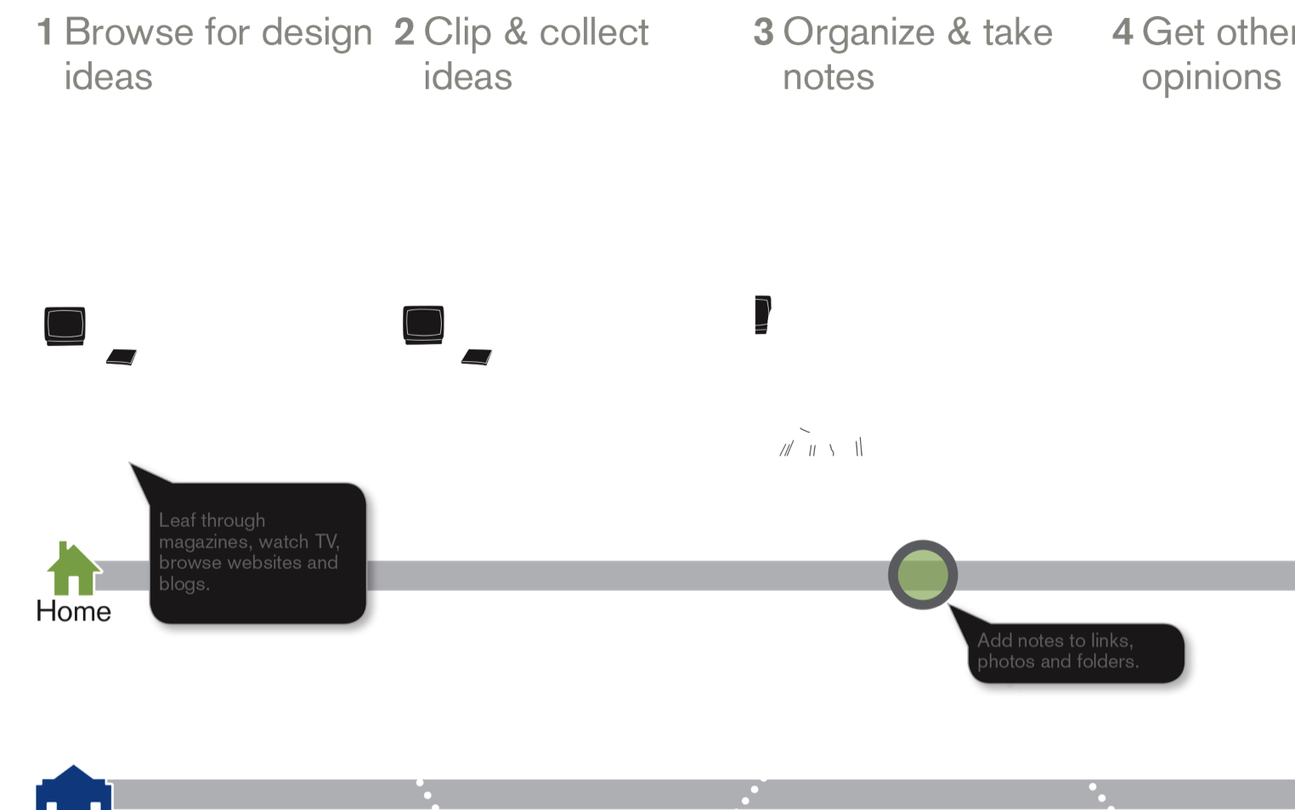
Notes:
If more comfortable with thinking about the user and their environment directly, this is a good place to use the storyboard.
And, feel free to use several methods. Some of these diagrams I am showing you were from the same project, just different ways of depicting and thinking about the user.
ADD CHINESE TRANSLATION HERE

Slide 38
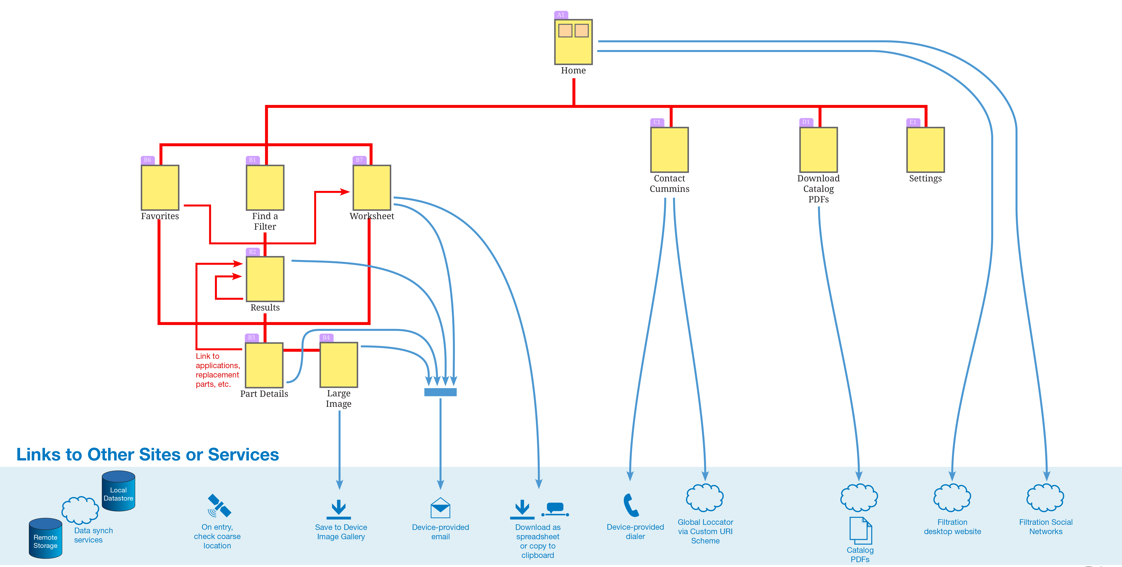
38
Notes:
You may be wondering, how do we think about data, and systems and connectivity? Well, do that also.
None of this is just about users, or just about any other one facet. Ideally, you never again make a document that disregards other layers of the stack. In this case, your data and interconnectivity is critical.
It might be hard to see, or to make everyone understand that a box is not about UI but process. You may need to extract it more explicitly like this with the row of external data sources and sensors along the bottom.
ADD CHINESE TRANSLATION HERE

Slide 39
EXERCISE:
IA/Task Flow
Notes:
So, grab more paper and sharpies, and draw one for your product.
Include what you need first, and don’t worry about the edges. Keep in mind resilience, so avoid error messages, settings, etc and see if you can keep the core information and interaction simple.
Make it device agnostic. Don’t worry about what system the user interacts with, and if you have to design in context, pantomiming holding a phone, instead keep changing the context, and have them look at computers, walls, wearables, etc.
20 MINUTES…
ADD CHINESE TRANSLATION HERE

Slide 40
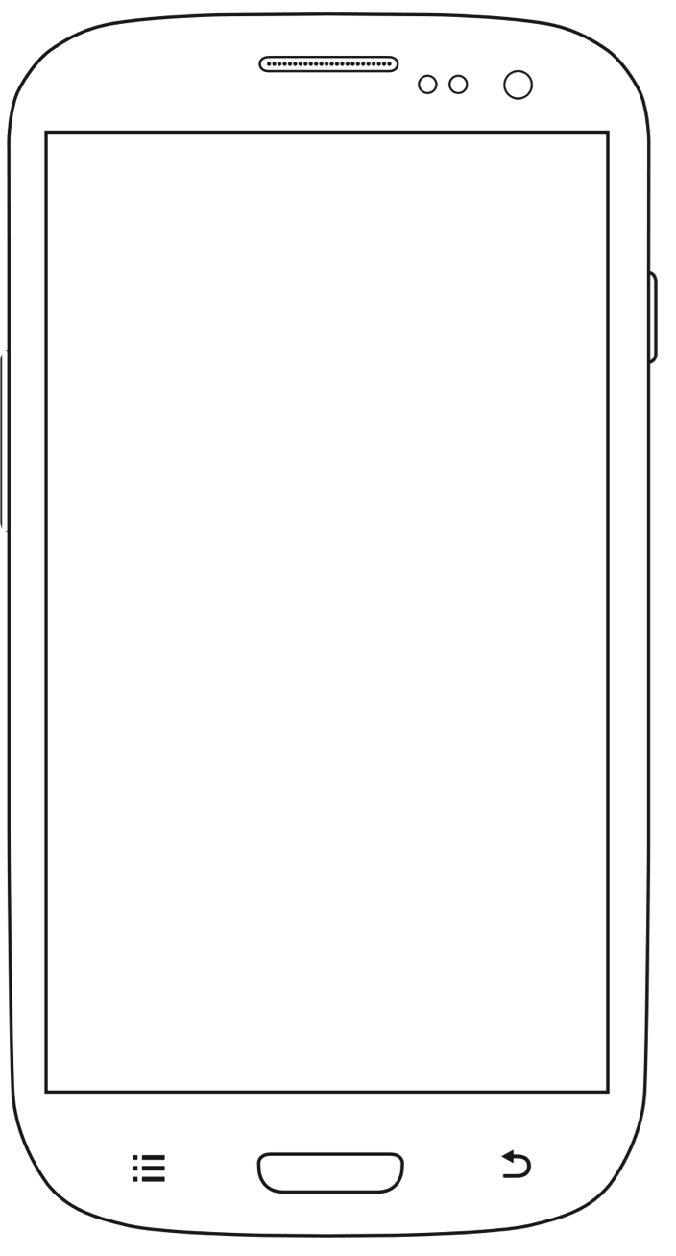
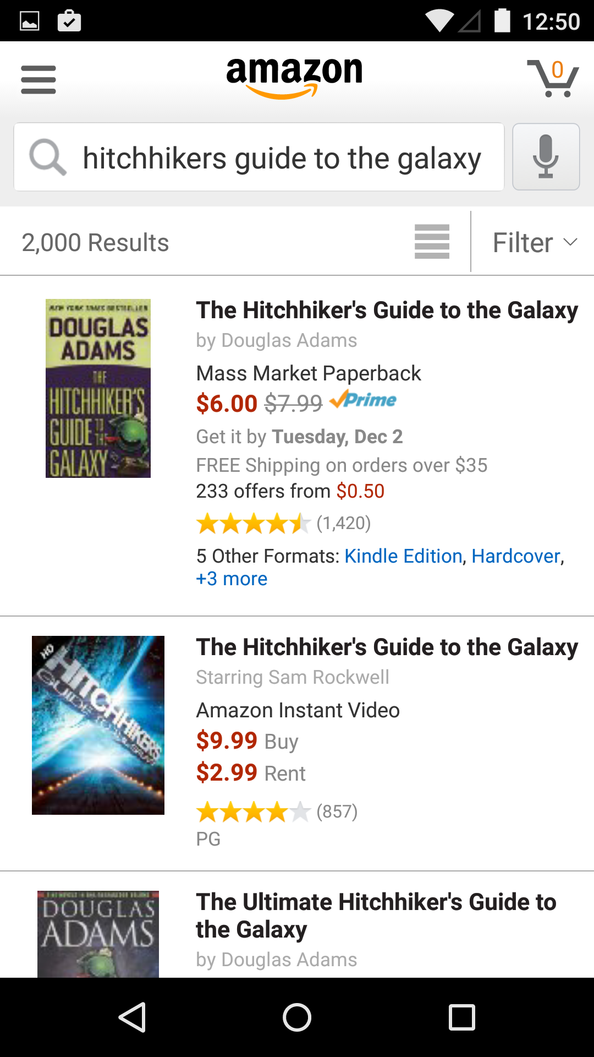
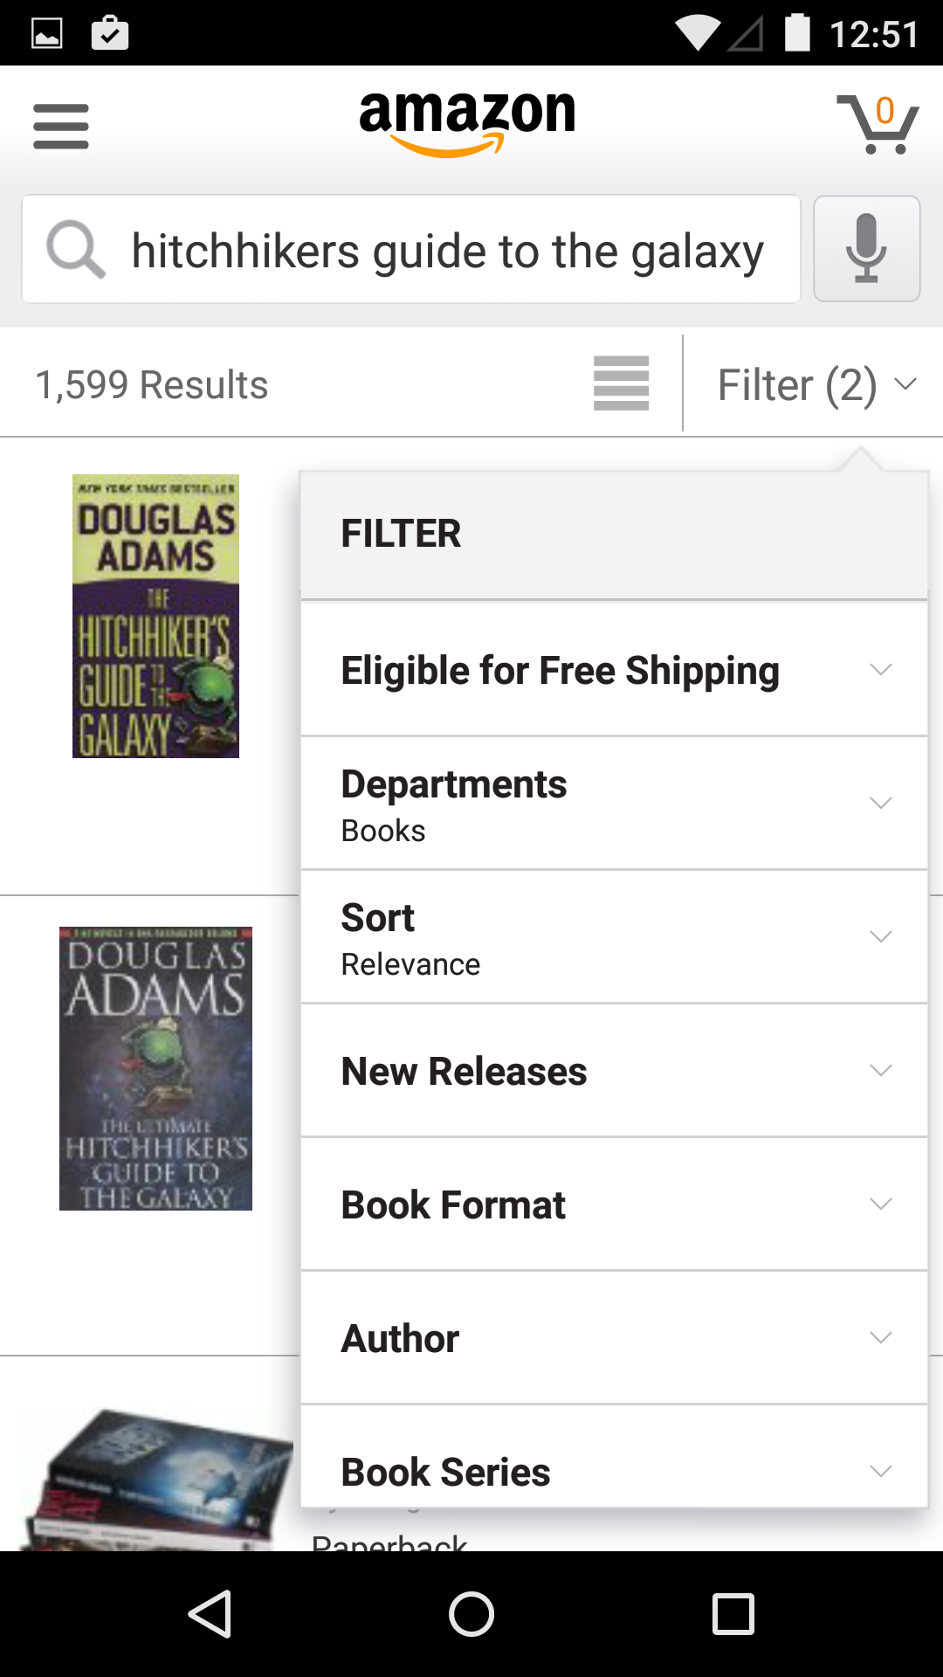
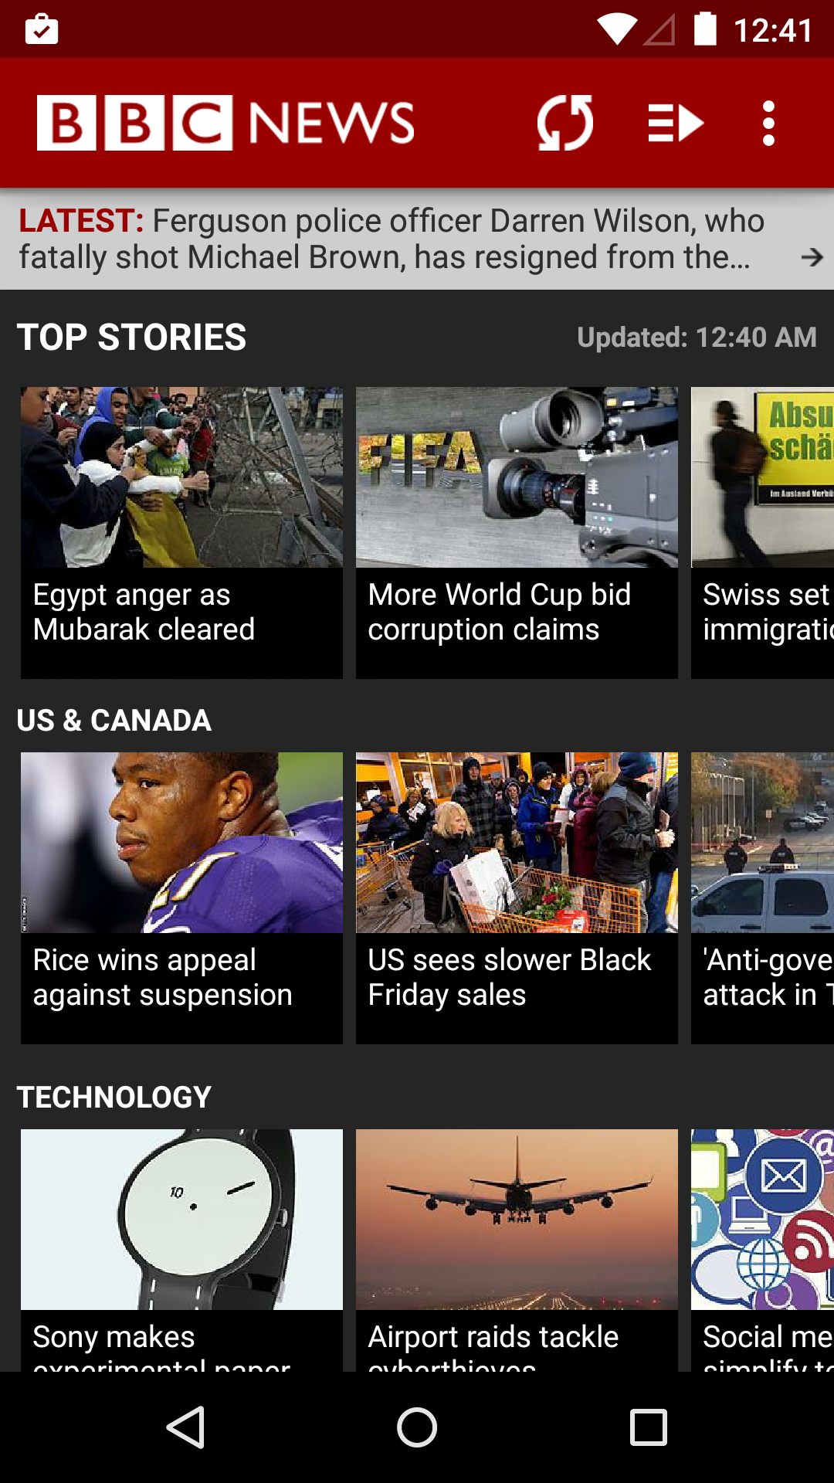
Notes:
Remember that end users do not see those diagrams. Don’t let anyone get worried about being confused by that, as long as the final interface doesn’t look confusing.
Do you know the IA of Amazon, or your favorite news source? Probably only a smattering of it. You know maybe that you should search on Amazon within books to make sure you can find the Hitch-Hikers Guide to the Galaxy book, instead of being flooded with results from that pretty mediocre movie.
ADD CHINESE TRANSLATION HERE

Slide 41
Notes:
Remember what I said: IA is not navigation, or wayfinding, but it can inform it. Like many news sources do, you can expose the categories not as tedious tab bars but as ways to Organize The Information organically. Users can find the story they are looking for, or the category of information.
ADD CHINESE TRANSLATION HERE

Slide 42
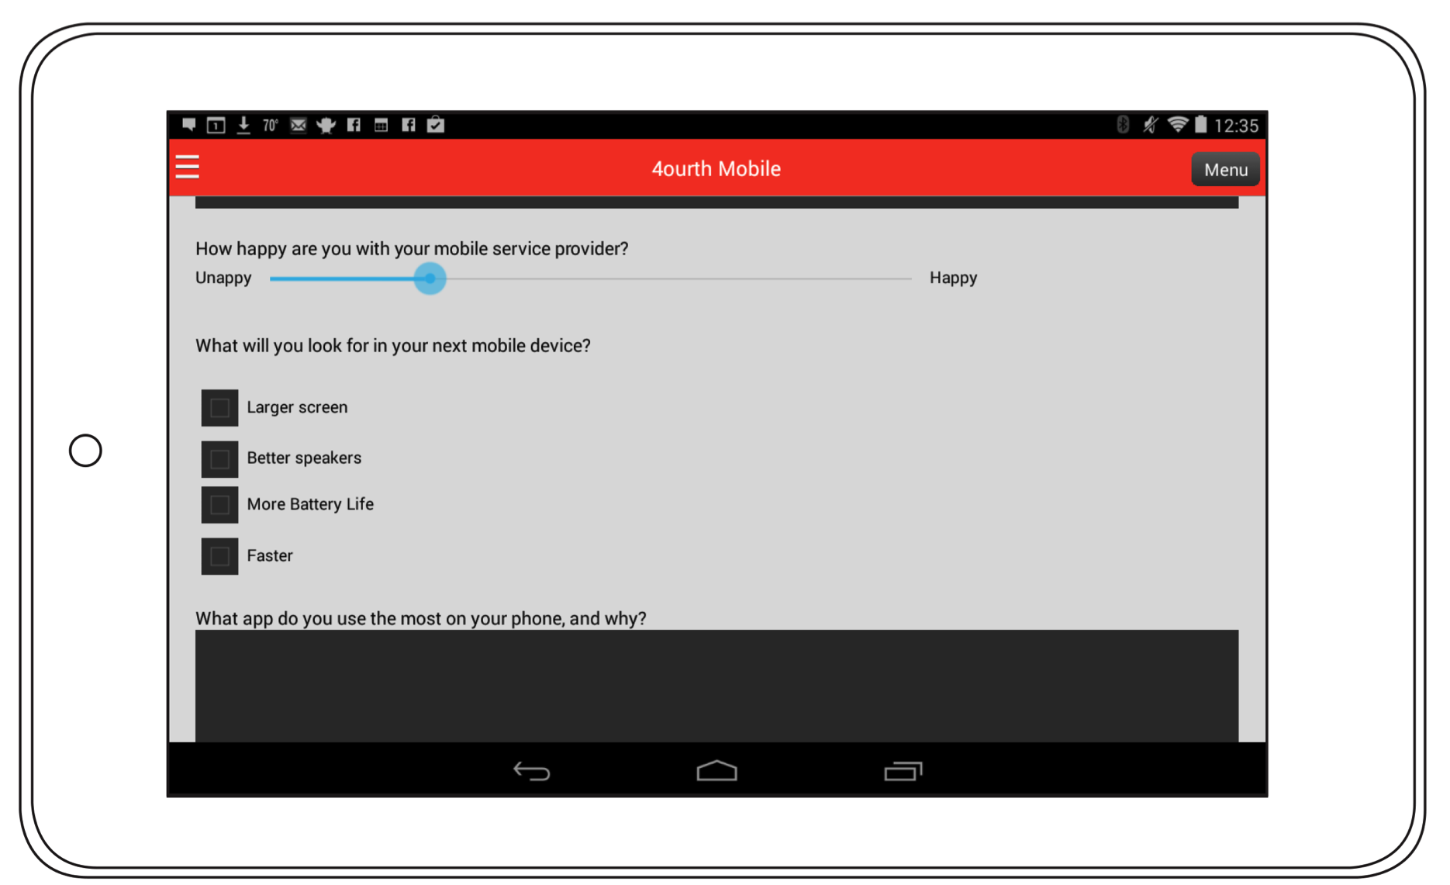
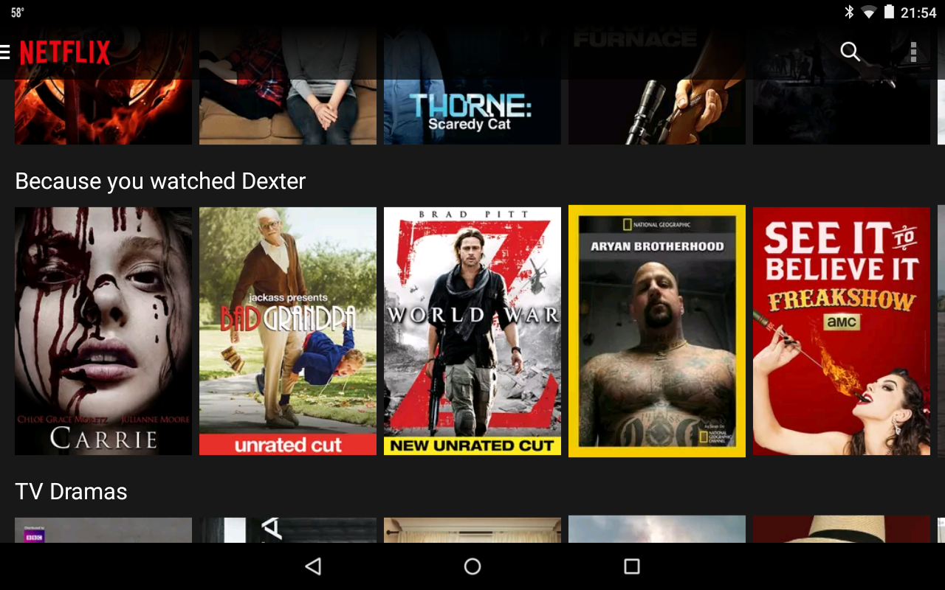
Notes:
I think we’re all familiar with how Netflix works as well like this. And here is a good example of complexity. Funny categories, and categories specific to your behavior can be exposed to make apparent how the system works, and help the user find content they want.
ADD CHINESE TRANSLATION HERE

Slide 43

Notes:
That may be too familiar. Let’s talk about something else. Like washing your hands.
We just want this at the end, dry hands, but all too often we get…
ADD CHINESE TRANSLATION HERE

Slide 44
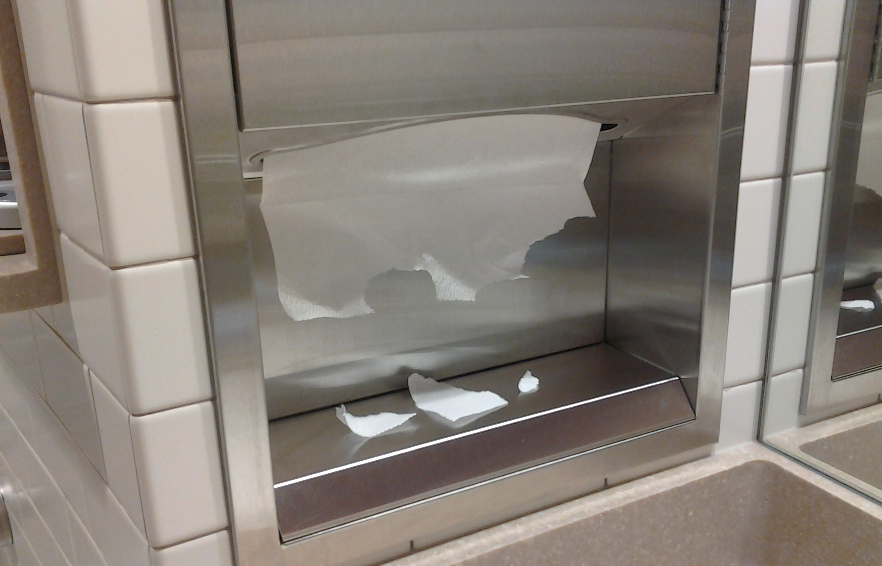
Notes:
This. Or nothing at all.
But setting aside implementation failures, the modern, powered, electronic paper towel dispenser causes us no end of trouble.
ADD CHINESE TRANSLATION HERE

Slide 45
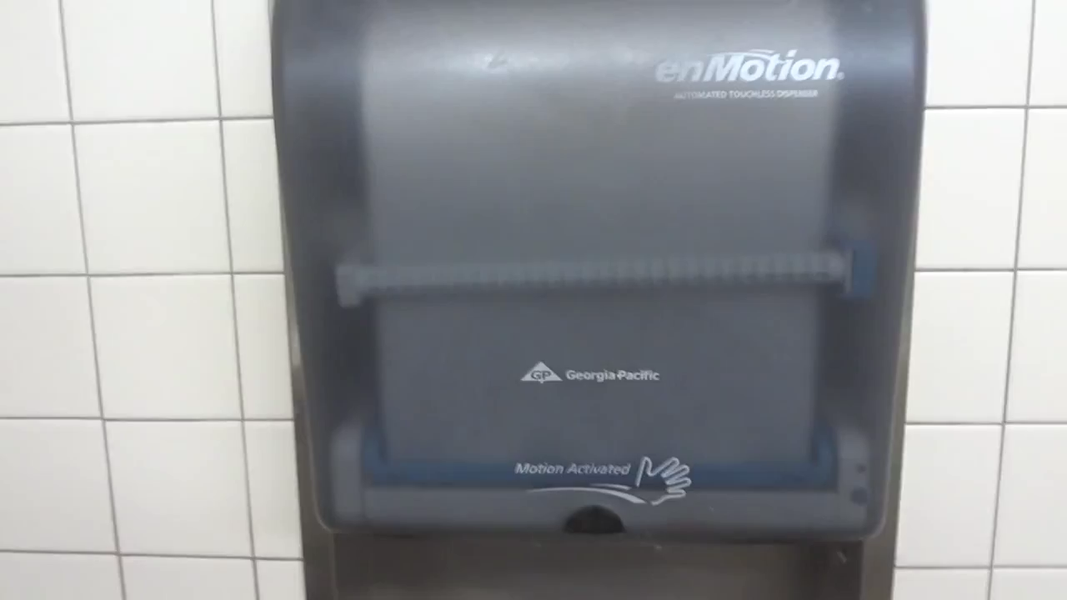
Notes:
Even if we figure out we have a hand-waving device, and it works, the motion is hilariously unnatural. What does this gesture have to do with getting a piece of paper?
ADD CHINESE TRANSLATION HERE

Slide 46
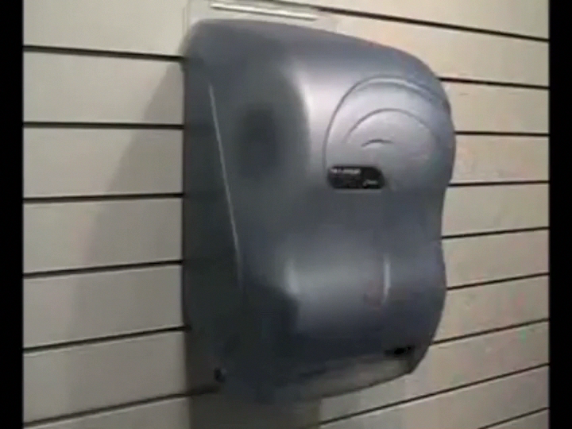
Notes:
I like these. Grab a towel, then another one comes out. The sensor is inside, so it’s more reliable.
Natural motion and everything.
ADD CHINESE TRANSLATION HERE

Slide 47
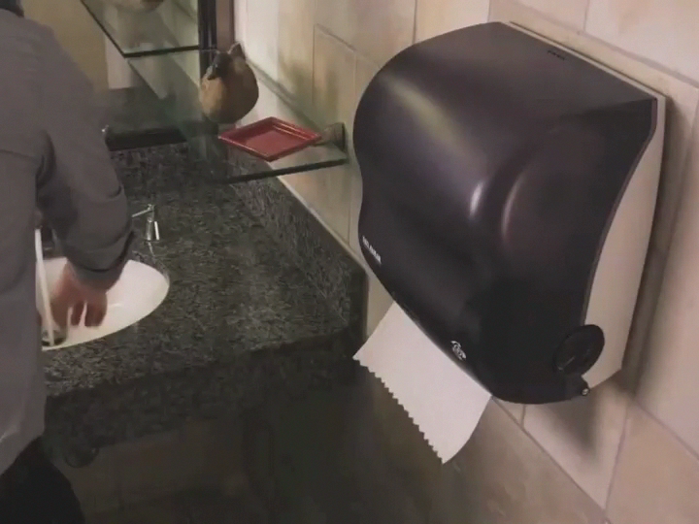
Notes:
But wait, why do we need batteries and sensors? This is how paper towel dispensers worked forever before we made them complex. Tug on one, another comes right out.
Lots of solutions I come up with for apps and websites are like this: email, paper, stickers, improving the hardware, fixing the database…
ADD CHINESE TRANSLATION HERE

Slide 48
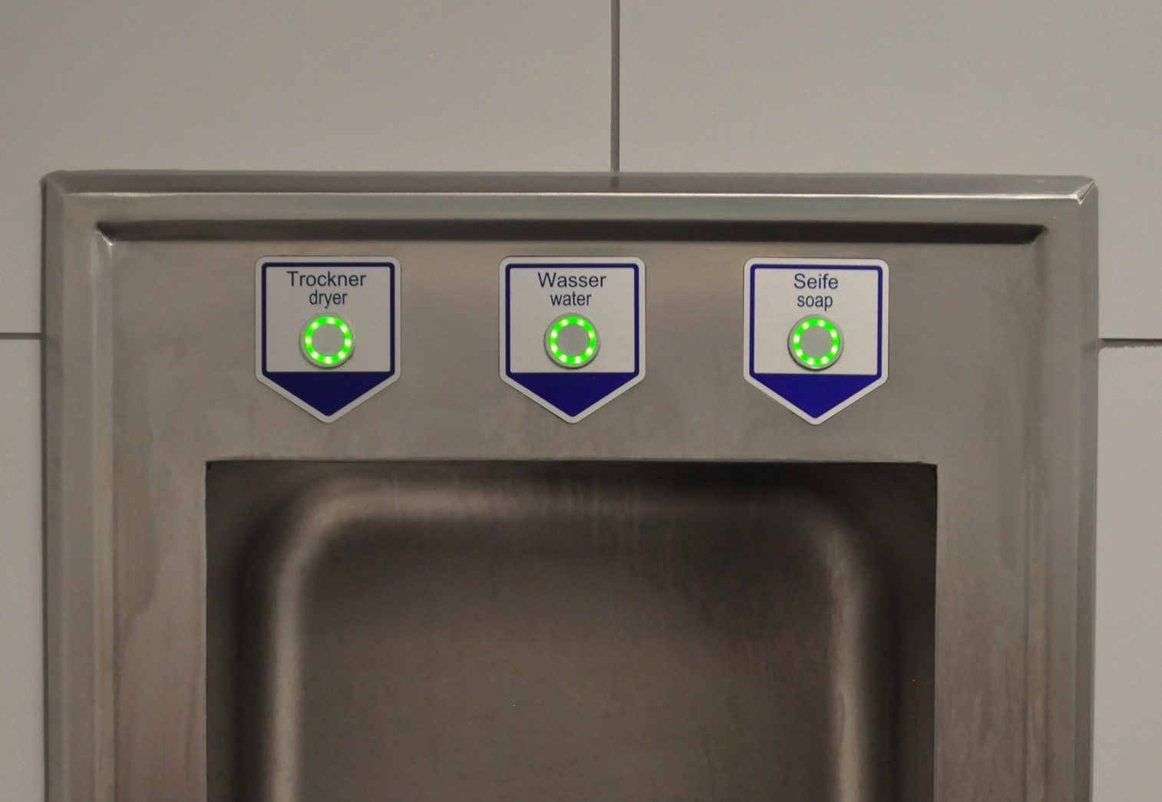
48
Notes:
But too often, this is the solution that gets the funding.
It’s a hand-washing station. You press a button for water, then a button for soap, then a button for water, then a button for air, then dry your hands on your shirt.
They each come out different places, so you move your hands to different positions. Which is not enough to turn it on!
You really do have to press a button. Wet, soapy, etc. In this day and age. Unsanitary? Mostly, un-necessary. Sensors are (seriously) cheaper than buttons and can make the experience a LOT better. There’s nothing about this product (which I actually encountered, and used) which is even marginally good, much less better than a hose, a bar of soap and a towel.
ADD CHINESE TRANSLATION HERE

Slide 49
Notes:
Don’t forget to solve problems, in the best way possible, for people… This is what people want, not more batteries to change, more UI’s to learn, etc. etc…
Is your product being awesomely technical and impressing your friends, or is it solving the one problem people need, in the easiest way, and just giving them dry hands?
ADD CHINESE TRANSLATION HERE

Slide 50
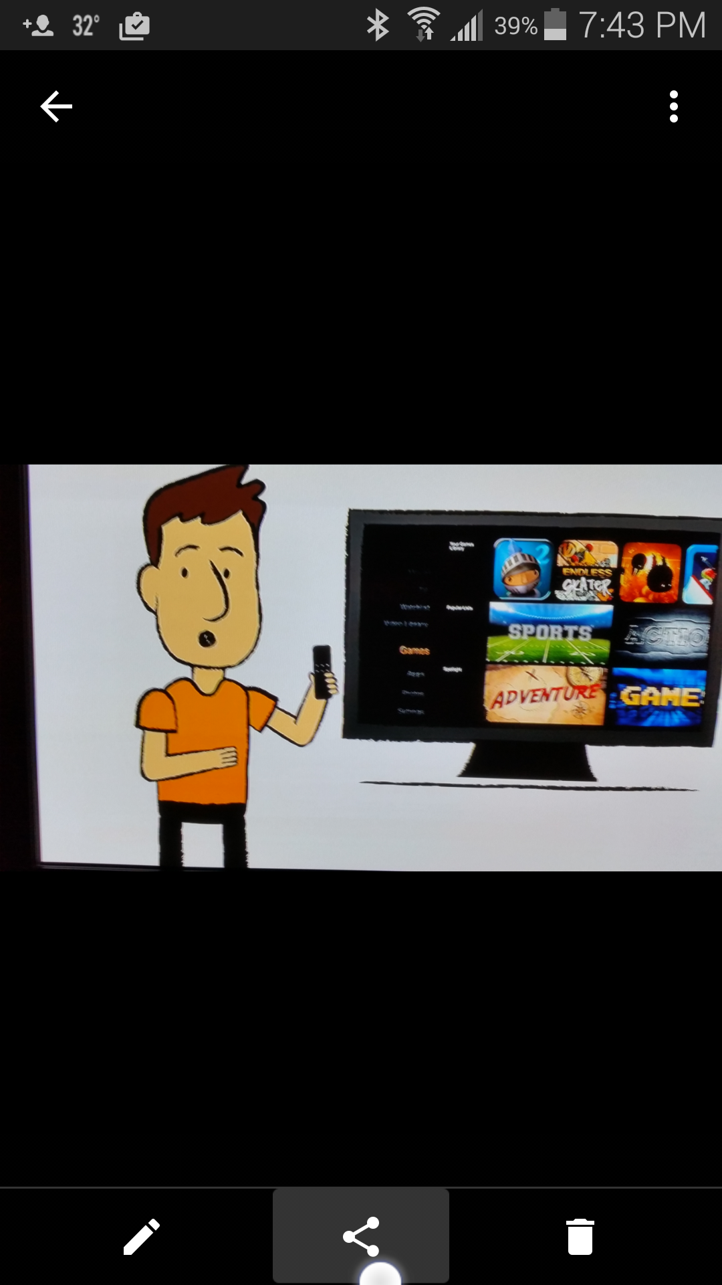
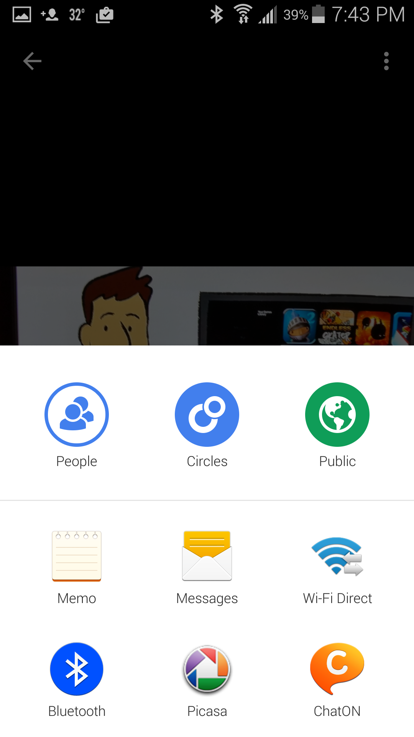
Notes:
Let me ground it in something more specific, and usable. Think back to the first exercise we did. Not just the team-building parts, but the solutions you came up with. How many of you solved it without adding a single button, word or anything?
SHOW OF HANDS.
On your computer when you want to share an image, you go to the tool you want to share with. Launch Twitter or go mail.google.com and then attach the file. But on mobiles, you just press the little share icon.
CLICK
And it loads an Intent. Your app (or with limits your website) can just say “I would like to share this” and the OS offers up apps that can handle it. This may sounds suspiciously similar to the way the OS monitors for Custom URIs, and that’s because it is.
ADD CHINESE TRANSLATION HERE

Slide 51
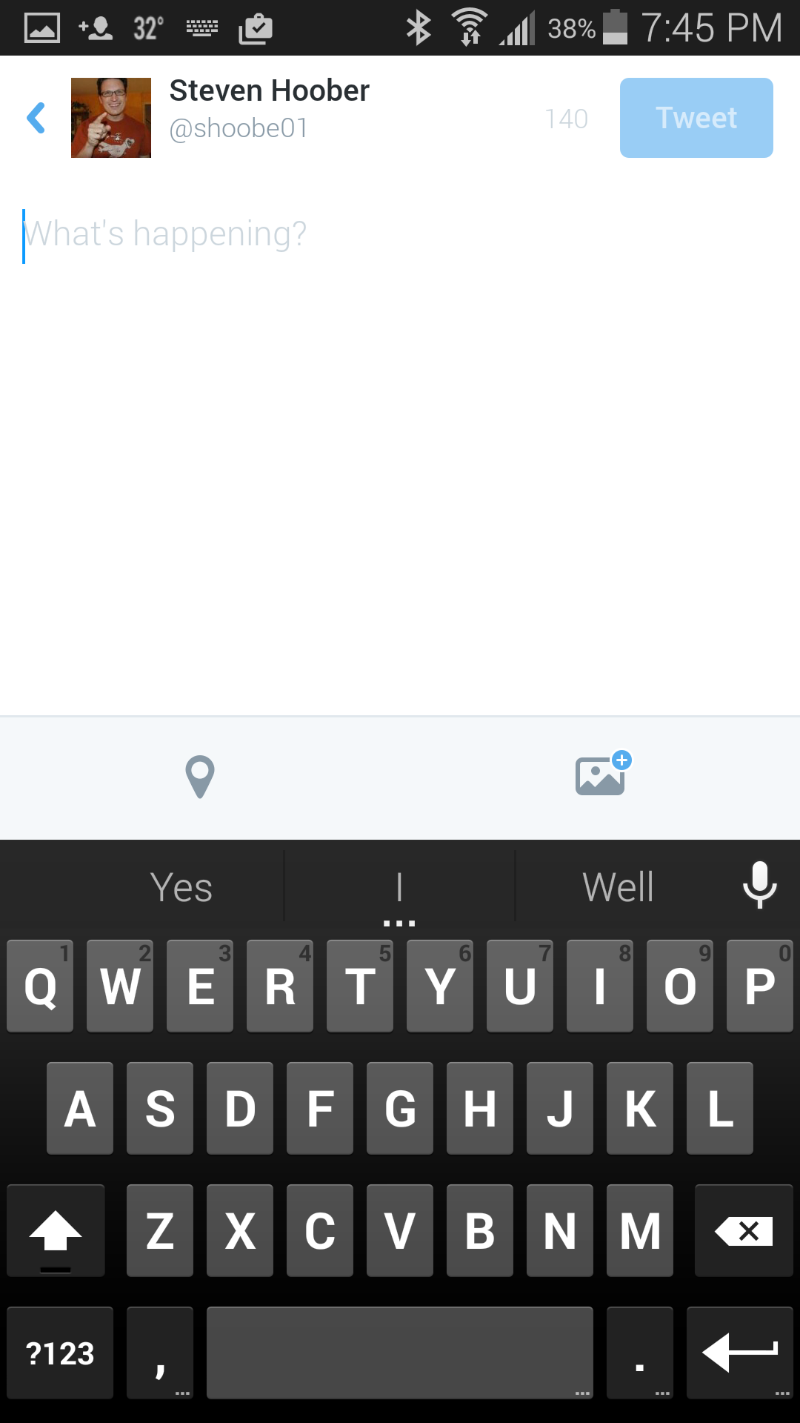
Notes:
This works for lots of tools. Assume you are building a tool that, like Twitter, allows you to attach images. You can integrate camera controls… but why bother?
Just add an image intent.
ADD CHINESE TRANSLATION HERE

Slide 52
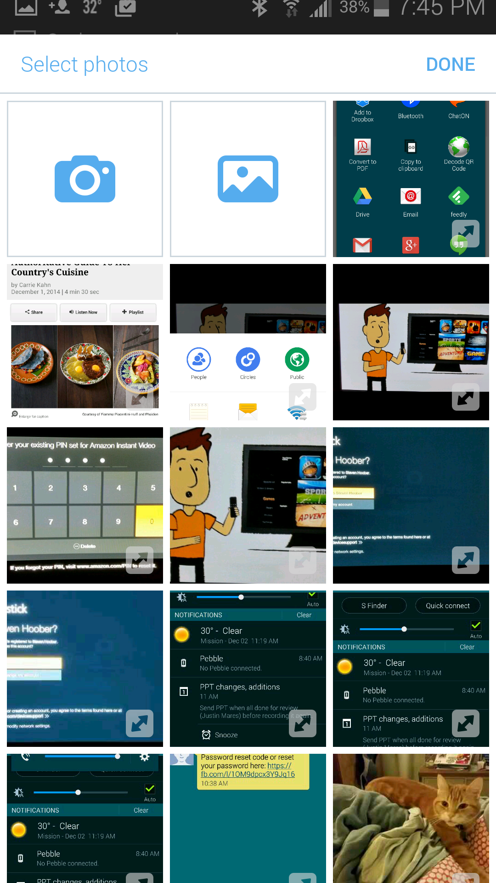
Notes:
And it pops up a function to select photos, or take a new one.
ADD CHINESE TRANSLATION HERE

Slide 53
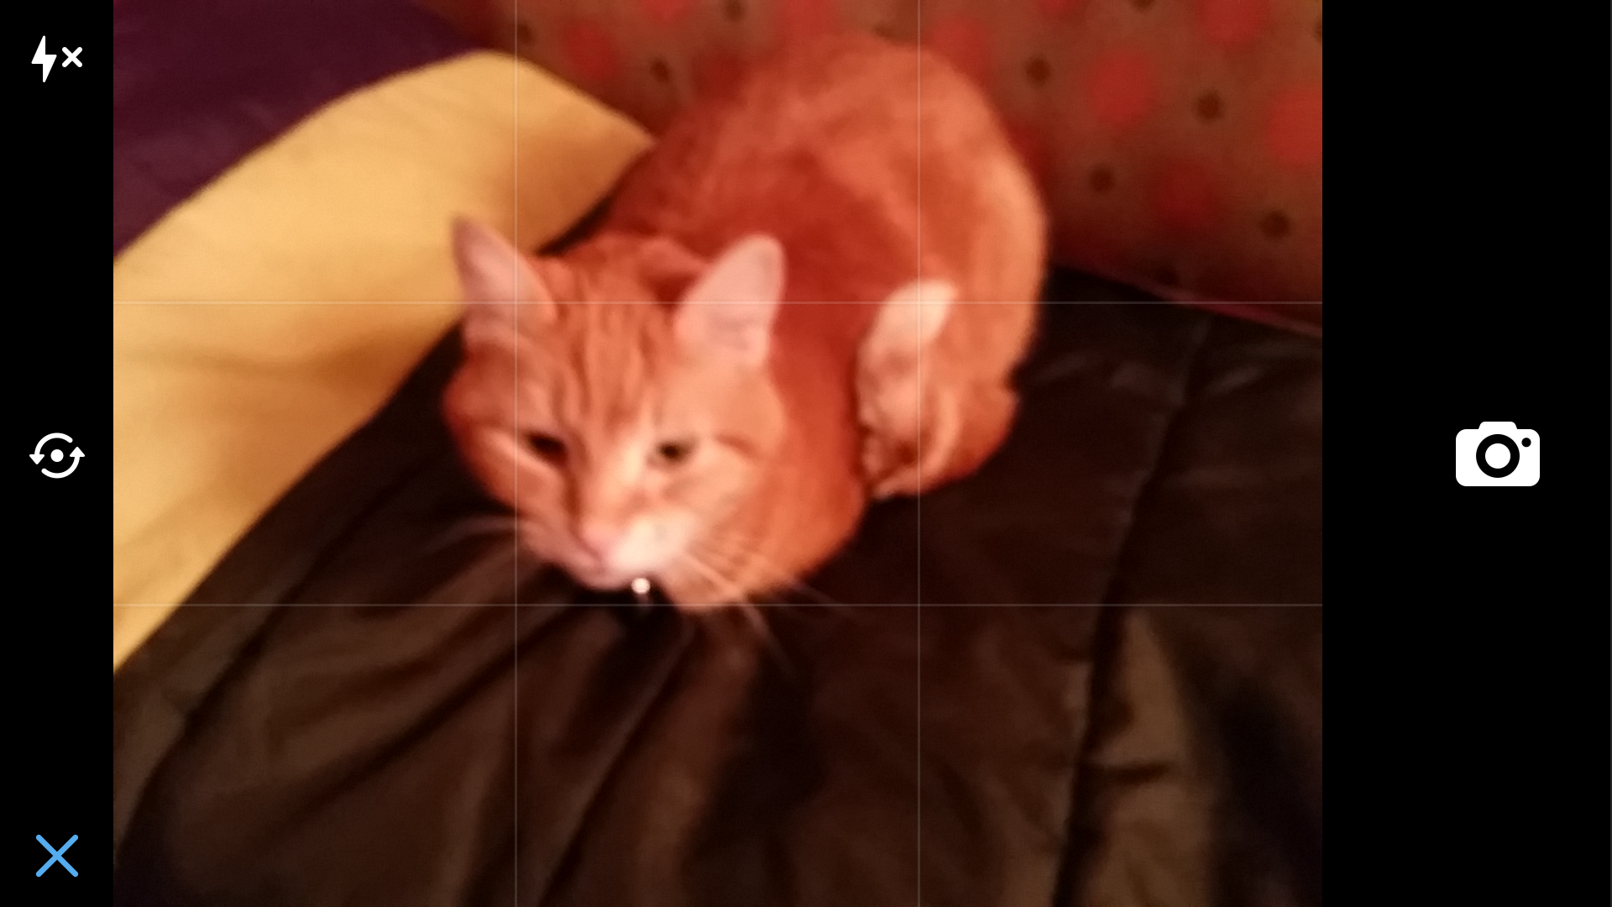
Notes:
There’s no learning curve, and massively less for you to actually build and test.
These tools are well designed to support these alternate use cases. Notice the X in the corner here to abandon the task?
ADD CHINESE TRANSLATION HERE

Slide 54
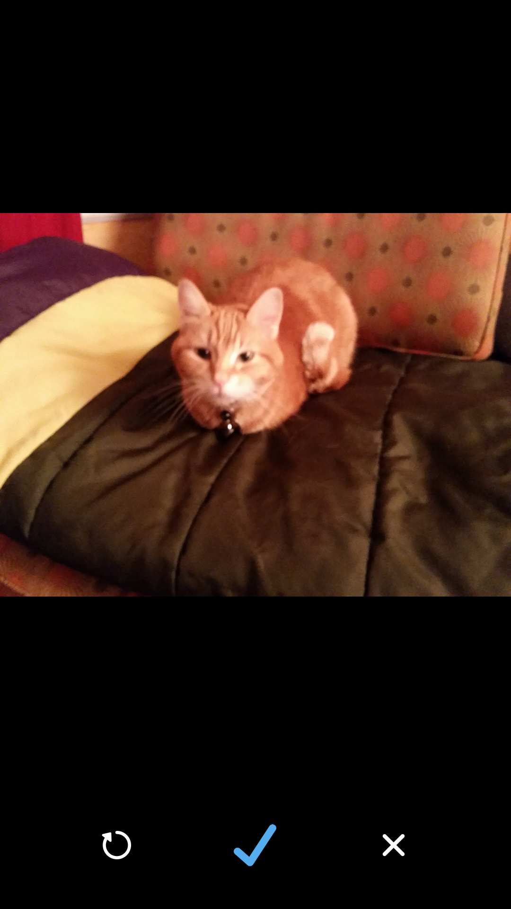
Notes:
Or the checkmark? You can retake, abandon or approve this for inclusion. Not part of Twitter, but of the camera app itself.
When done with an intent like this, it generally takes the user back to the parent app, so no worries about leaving either.
Lots of tools do this. I like to often talk about email forms. Great on your website, but for mobile web and apps, that’s just wrong. You link to installed applications because that’s the expectation and method of operation of mobiles. For email, when the user clicks to send feedback, they get their native email client (or a choice of them first), pre-populated with whatever information you want to load. But they can use their device the same way they do any other time.
ADD CHINESE TRANSLATION HERE

Slide 55
EXERCISE:
Interface and Interaction
Notes:
Now we’re going to draw some of the interface and interaction your users will encounter.
ADD CHINESE TRANSLATION HERE

Slide 56
EXERCISE:
Two states
Two platforms
Notes:
Don’t get too overboard. Pick two states (screens if that makes you happy), that are related to each other, and do those on two different platforms.
Very different ones. If you do a phone, do not also do a tablet, but a watch, glasses, wall display, email, or whatever crazy sky laser hardware you came up with.
ADD CHINESE TRANSLATION HERE

Slide 57
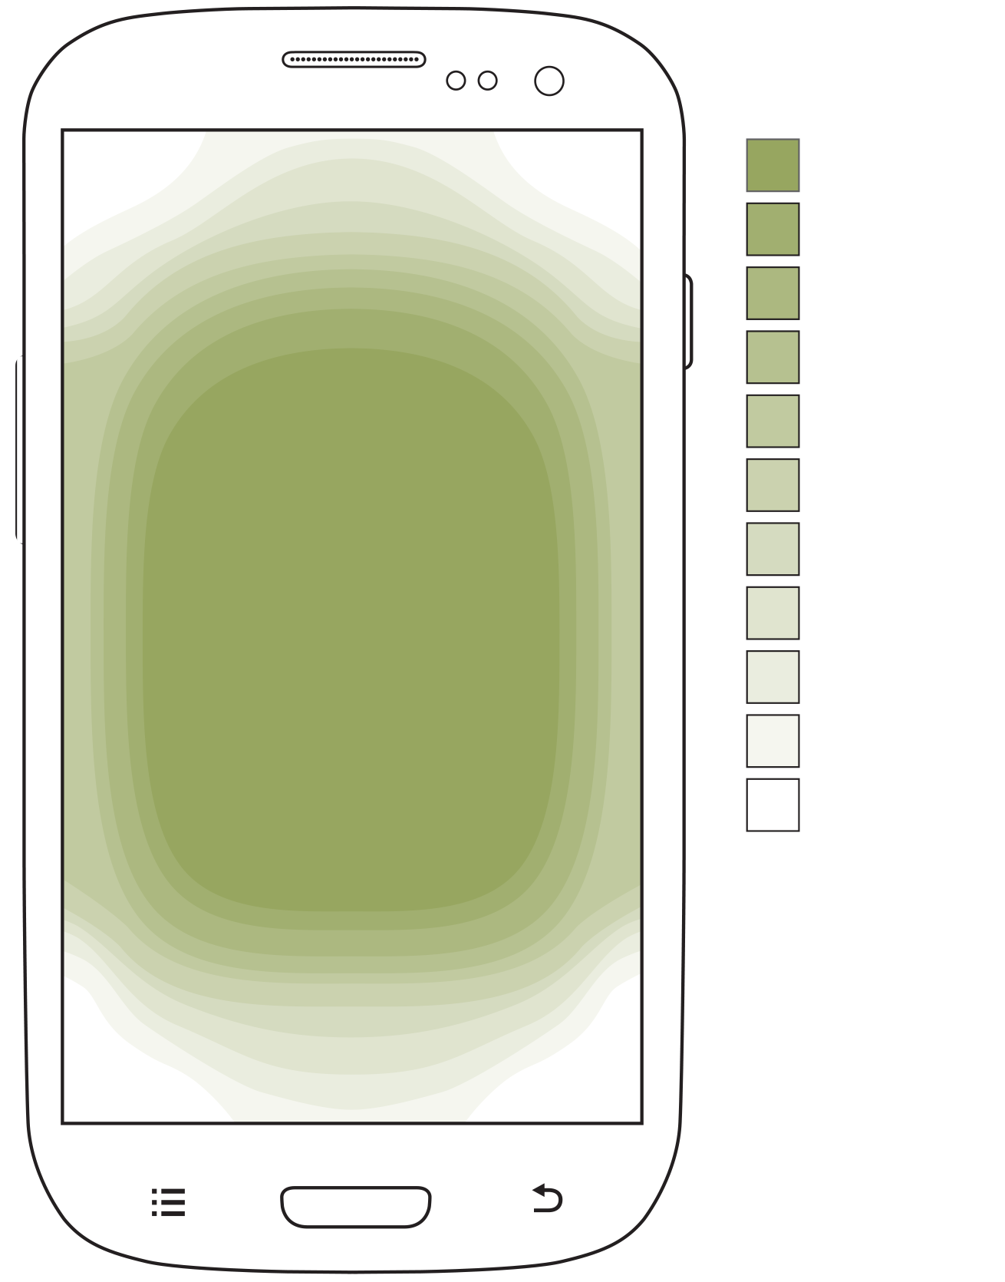
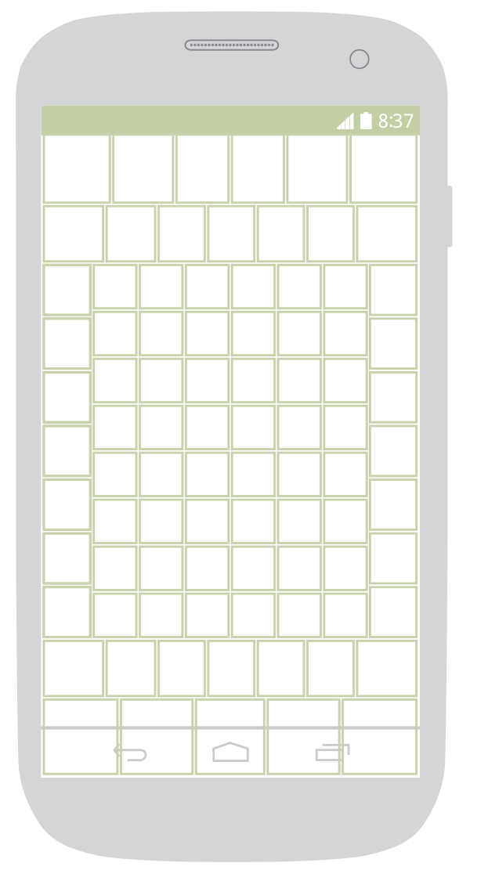
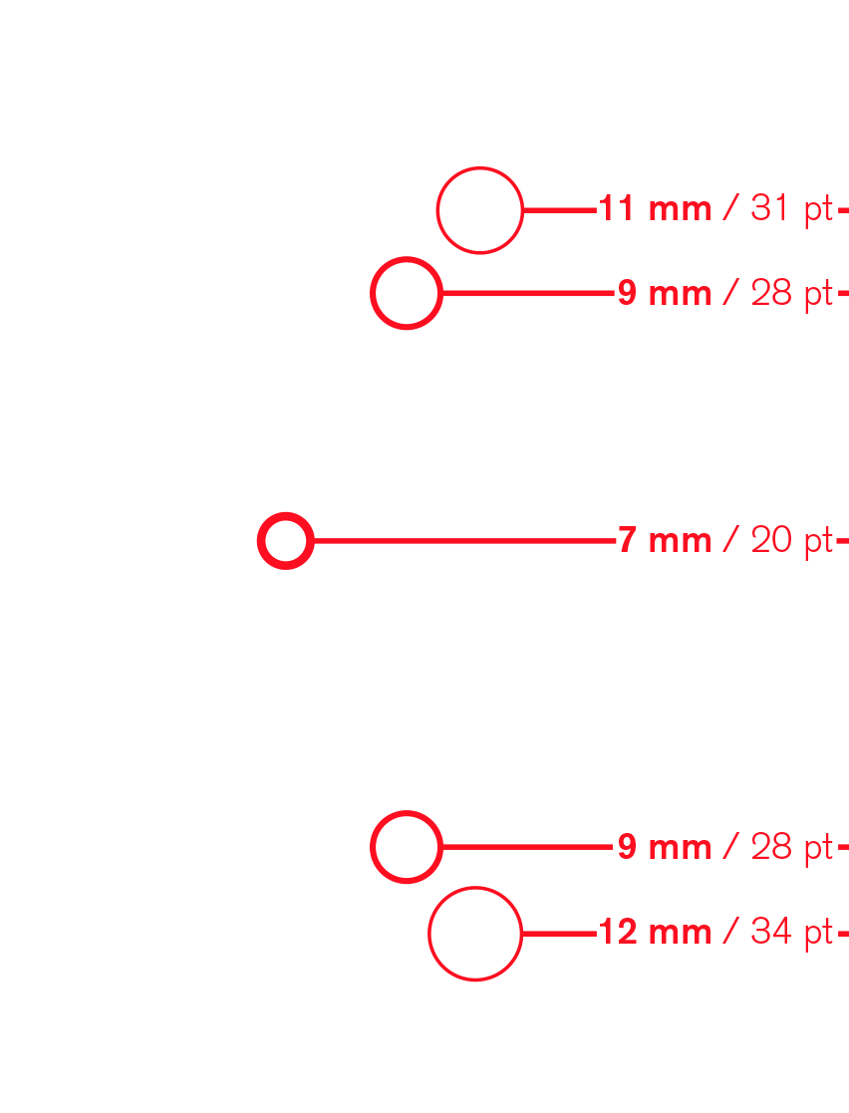
Notes:
Come get paper to draw on. I have stencils for a smartwatch, phones, phablets and tablets.
The touchscreen devices have these green lines, to remind you of this, where people look and touch the most, and most accurately. Tops and bottoms and menu buttons are secondary items.
For your other platforms, just draw the interface frame as best you can. Try to keep it in scale, so if doing a TV, grab another piece of chart paper, and check it by backing up 10 feet.
ADD CHINESE TRANSLATION HERE

Slide 58
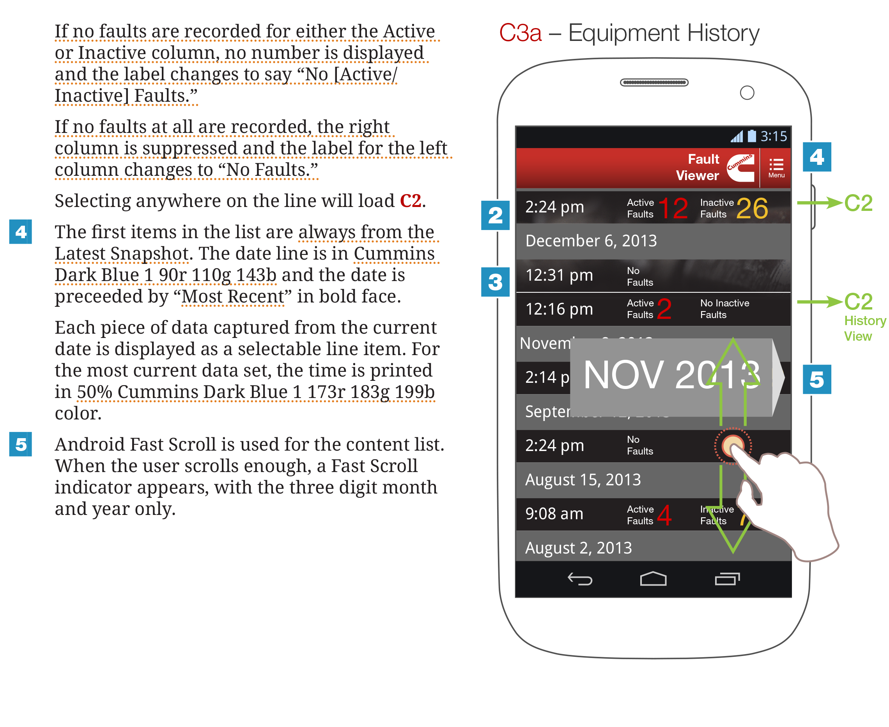
Notes:
Do not just draw the screens. Remember, you shouldn’t have only screens. Draw /interactions/. I hear lots of griping that you have to prototype to do this, but without getting into too much detail, I disagree. A lot.
Draw what happens when you click, tap, swipe or scroll. Draw vibrate, and blink. Specify timings, colors, sizes. Figure out when you display one state, vs the other, and when you switch between them. How do you transition between them?
Do this as a direct descendent of the task flow you will discover things like delay, or find ways of avoiding them. Things you would NOT discover if you prototyped with fake data, on a computer.
20 MINUTES (or whatever is left minus 10)…
ADD CHINESE TRANSLATION HERE

Slide 59

Notes:
…
Remember to keep people in mind. People do not change, and their POV is more important than pixel sizes, or anything else about the platform or device.
ADD CHINESE TRANSLATION HERE

Slide 60

Notes:
…But also account for the ways people use different devices due to their environment and context.
Larger handheld devices (phablets and tablets) are used further from the eye, and less on the move.
ADD CHINESE TRANSLATION HERE

Slide 61

Notes:
…But also account for the ways people use different devices due to their environment and context.
Or the way they are perceived. This is Google’s reminder that the depth baked into all systems (but described well in Material Design) is dependent on device distance.
ADD CHINESE TRANSLATION HERE

Slide 62

Notes:
Understand that people use their mobiles not just on the go, but all day, everywhere they go.
ADD CHINESE TRANSLATION HERE

Slide 63

Notes:
The installed base of desktop and laptop computers is DROPPING, and even in the US more people use mobiles than computers for everyday tasks.
I expect similar behaviors as we get wearables and other connected devices out in the world; people use the device they want, for the context they need. So do not plan for overly tight use cases.
ADD CHINESE TRANSLATION HERE

Slide 64
Notes:
This was a quick overview, and I didn’t get to all of it so I could let you do some hands on work. You need to also: talk to end users, watch them work, understand technology deeply, test and iterate, and much more.
ADD CHINESE TRANSLATION HERE

Slide 65

Notes:
Thanks very much for your time today.
In case you don’t know who I am:
I have written books, and regularly write articles, even ones published in paper magazines.
ADD CHINESE TRANSLATION HERE

Slide 66


Notes:
I have been designing since apps like this were totally awesome and ground breaking, for carriers, manufacturers and many more companies than I have listed here. Yeah, I worked for Sprint for 9 years, which is where a lot of my phone knowledge came from.
ADD CHINESE TRANSLATION HERE

Slide 67




Contact me for consulting, design, to follow up on this deck, or just to talk:
^{Steven Hoober}
^{steven@4ourth.com}
⁺¹ ⁸¹⁶ ²¹⁰ ⁰⁴⁵⁵
^{@shoobe01}
^{shoobe01 on:}
^{www.4ourth.com}
Notes:
And I do all this because I have an abiding sense of disappointment over where we are, and optimism over where we could be.
If you have questions or need more info, follow me, or contact me directly. If you miss these addresses or your phone doesn’t have the resolution, just Google my name and you’ll find me.
TIME FOR QUESTIONS?
CLOSING: CARDS, STICKERS, TOUCH TEMPLATES
ADD CHINESE TRANSLATION HERE

